Slide 1



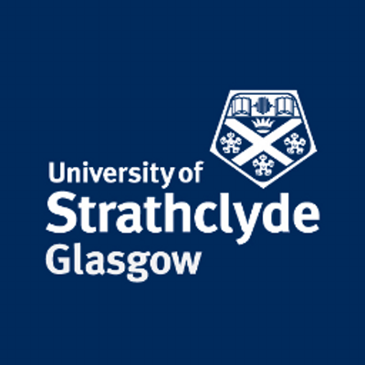


Strathclyde Physics Alumni Careers Event
Wednesday 20th March 1-3pm in JA502
All welcome!
Marie Claire Cairns, NPI Manager at Coherent
Pauline Hall-Barrientos, Medical Physicist at NHS Greater Glasgow and Clyde
Leanne Ramage, Head of Projects at Natural Power
Alistair Davy, PhD at University of Strathclyde
Colin Scott, Owner of CS Guitars
Martin Grant, Electrical Systems Engineer at Atkins

