Slide 1

Student Module Evaluation
Phase 1 Information and Guide
12 November 2019

Slide 2
Phase 1 Module Evaluation:
Process Overview
Student receives email to complete module evaluation. Links to evaluation questionnaires also available in Myplace site pages and pop-up on login
Student completes online module evaluation questionnaire
Reminder emails issued to students who have yet to complete their evaluation
Evaluation window closes
Reports issued to teaching staff via email and available on Myplace link
Teaching staff invited via email to add reflections on student feedback
Reports issued to students with teaching staff comments (via email and Myplace link)
Final reports issued to teaching staff complete with their comments
Teaching staff invite students to complete evaluation in class using their portable device

Slide 3
Students can access module evaluation surveys in several ways:
A personalised email inviting them to complete their module evaluations – this will link to a task page in Myplace with all of their outstanding evaluations to complete (one link per module) – see slide 4
A personalised pop-up when they log into Myplace – see slide 5
A link to the evaluations from the module’s Myplace site – see slide 6
A link to the evaluations task list is contained in the Myplace navigation block
To maximise response rates we would also like teaching staff to invite students to complete the evaluation in class using a mobile device (or laptop if they have brought one).
  Our previous work has highlighted that taking 10 minutes at the start of a lecture or class is the most effective time to do this.
  The module evaluation project team can come along to the beginning of the class to support
If your teaching classes have already finished for the semester, you may wish to send a short message to students via a Myplace class notice.

Slide 4
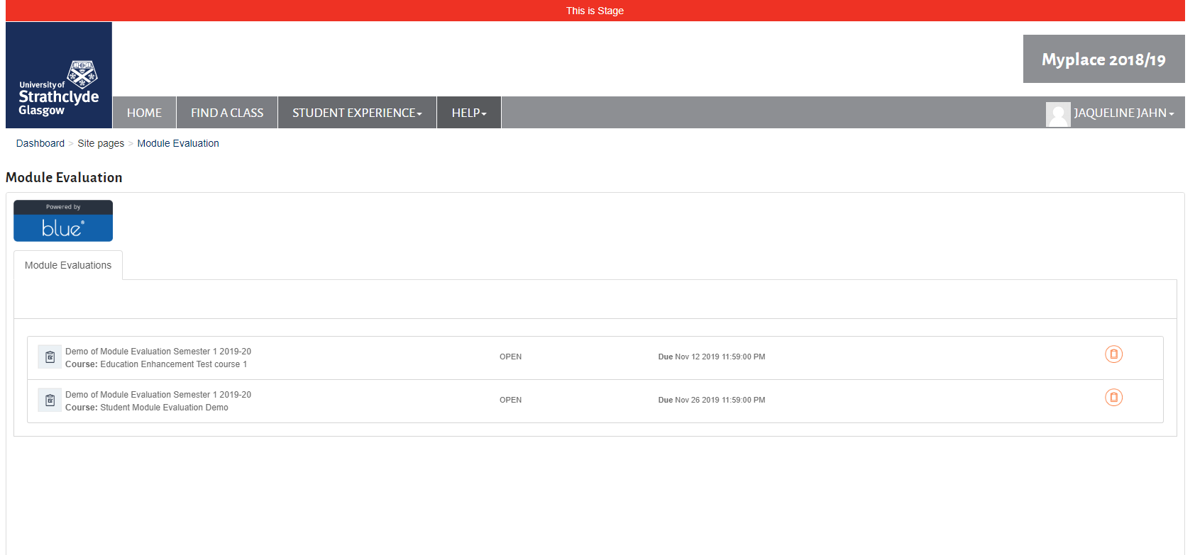
Task list for module evaluation
A task list like this will appear when students click on the link in their email or in their pop-up message. They can click on the link for the class they want to evaluate.

Slide 5
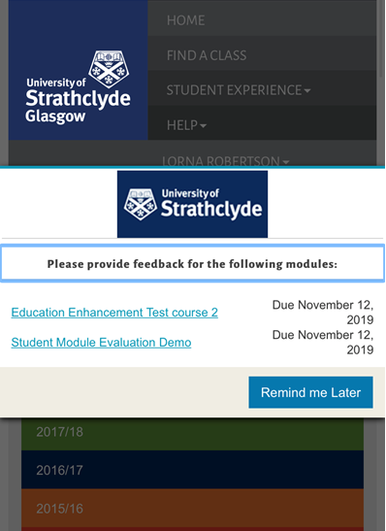
Pop-up in Myplace
When inviting students to complete the evaluations in class:
Log in to Myplace using your own details as normal
This can be done on a laptop, tablet or smartphone
You should see a pop-up message inviting you to complete your evaluations
Click on the link for the module you want to evaluate
If the pop-up doesn’t appear or you have dismissed it:
  Navigate directly to the module Myplace site and access the evaluation (see slide 6)
Students will see a pop-up like this when they log into Myplace, with a list of all of the evaluations they have to complete. The example here shows the pop-up on a mobile device.
Notes:
You can use this guide to help students to find the module evaluation survey links if needed

Slide 6
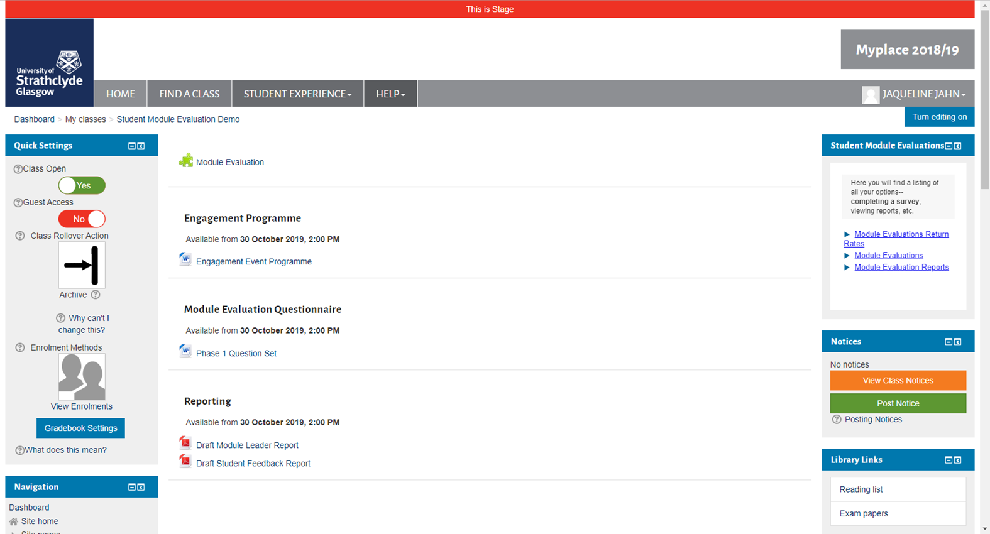
Accessing Module Evaluation in Myplace from the class site
Students can find the link to module evaluations on the right hand side of the Myplace class site.
Select the Module Evaluations option.
Teaching staff will also see this block on the right hand side – use this to monitor response rates and view reports when they are ready
Notes:
You can use this guide to help students to find the module evaluation survey links if needed

Slide 7
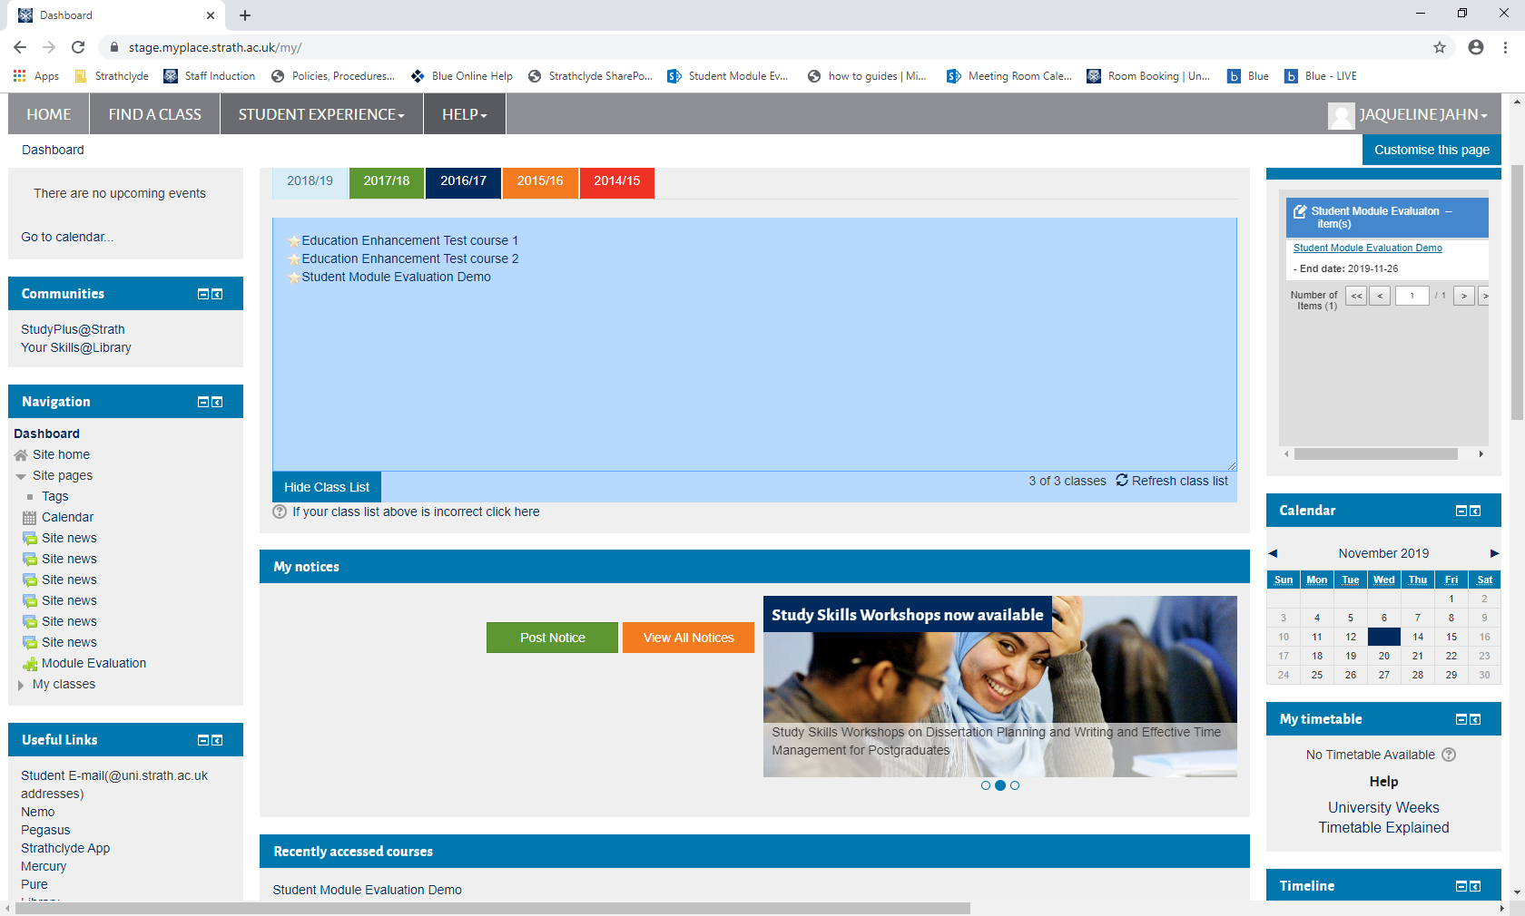
Accessing Module Evaluation in Myplace from the Navigation block
Students and teaching staff will be able to access their Module Evaluation task list from the Navigation block.
Click on Site Pages then Module Evaluation.
This will bring up a list of modules to be evaluated or tasks to be completed (Course Organiser response to student feedback and report viewing will also appear in here when they are relevant).
Notes:
You can use this guide to help students to find the module evaluation survey links if needed

Slide 8
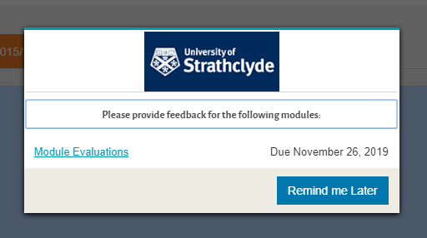
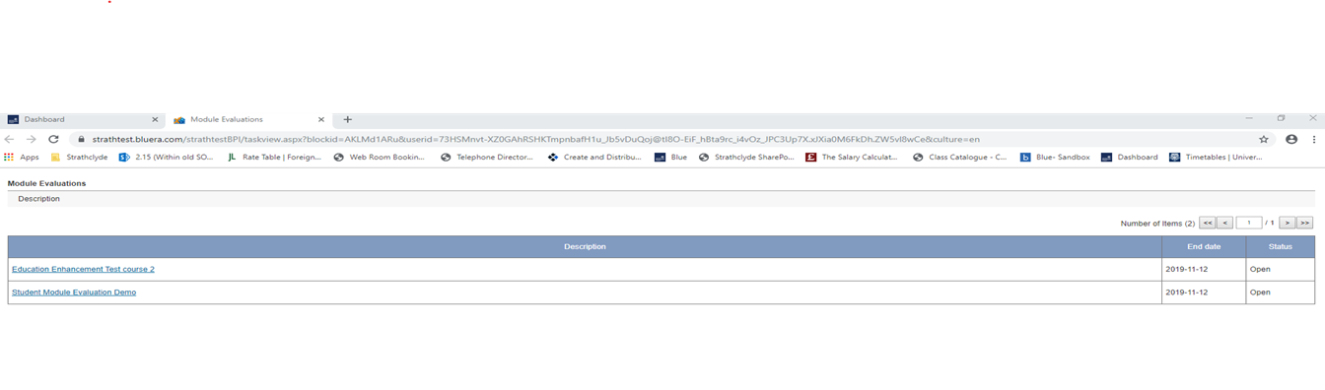
Completing the questionnaire
From the pop-up:
  Click on the link in the pop-up
  This will open a table like the one below – click the link for the relevant module to complete the evaluation
Students will see a different link for each module they have to complete an evaluation for
The pop up will only contain links for the evaluations students have yet to complete
In the table they will also see which they have already completed and which are outstanding

Slide 9
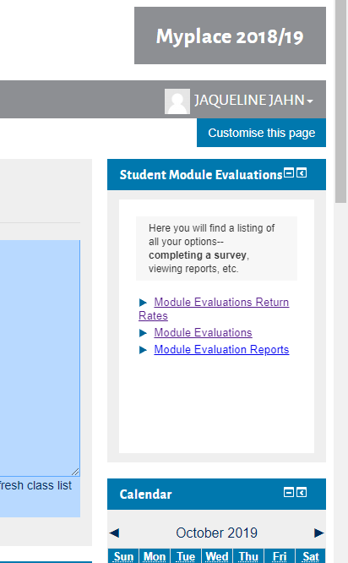
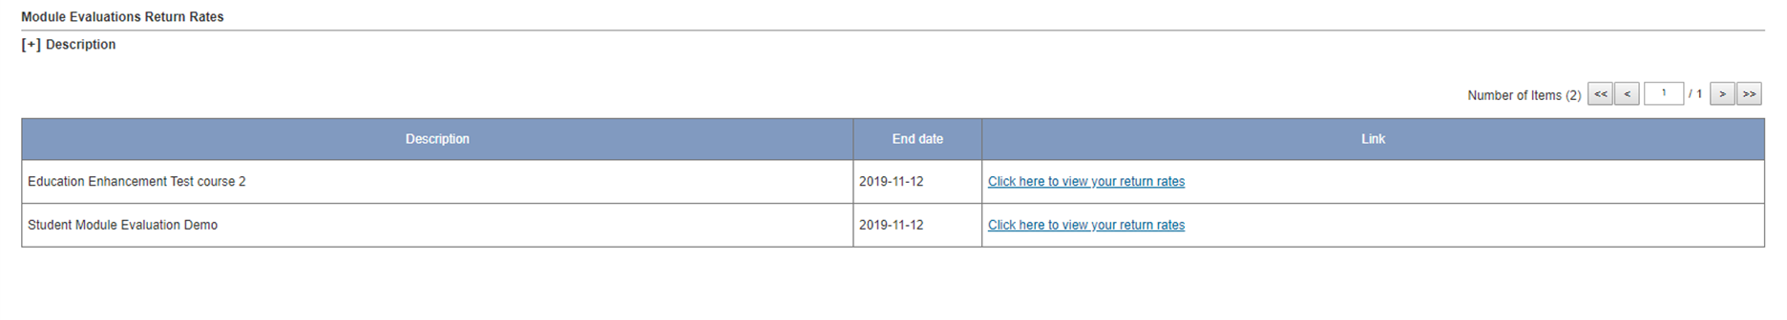
Monitoring response rates
Navigate to your module’s Myplace site
In the Student Module Evaluations block on the right hand side, click on Module Evaluations Return Rates
This will bring up the table below showing all of the modules you are teaching on and allow you to view response rates for each
The table also shows the close date for each module
You can see the response rates at any time while the evaluations are open
Note: in the demo site, you will see a message saying you have no open evaluations at this time

Slide 10
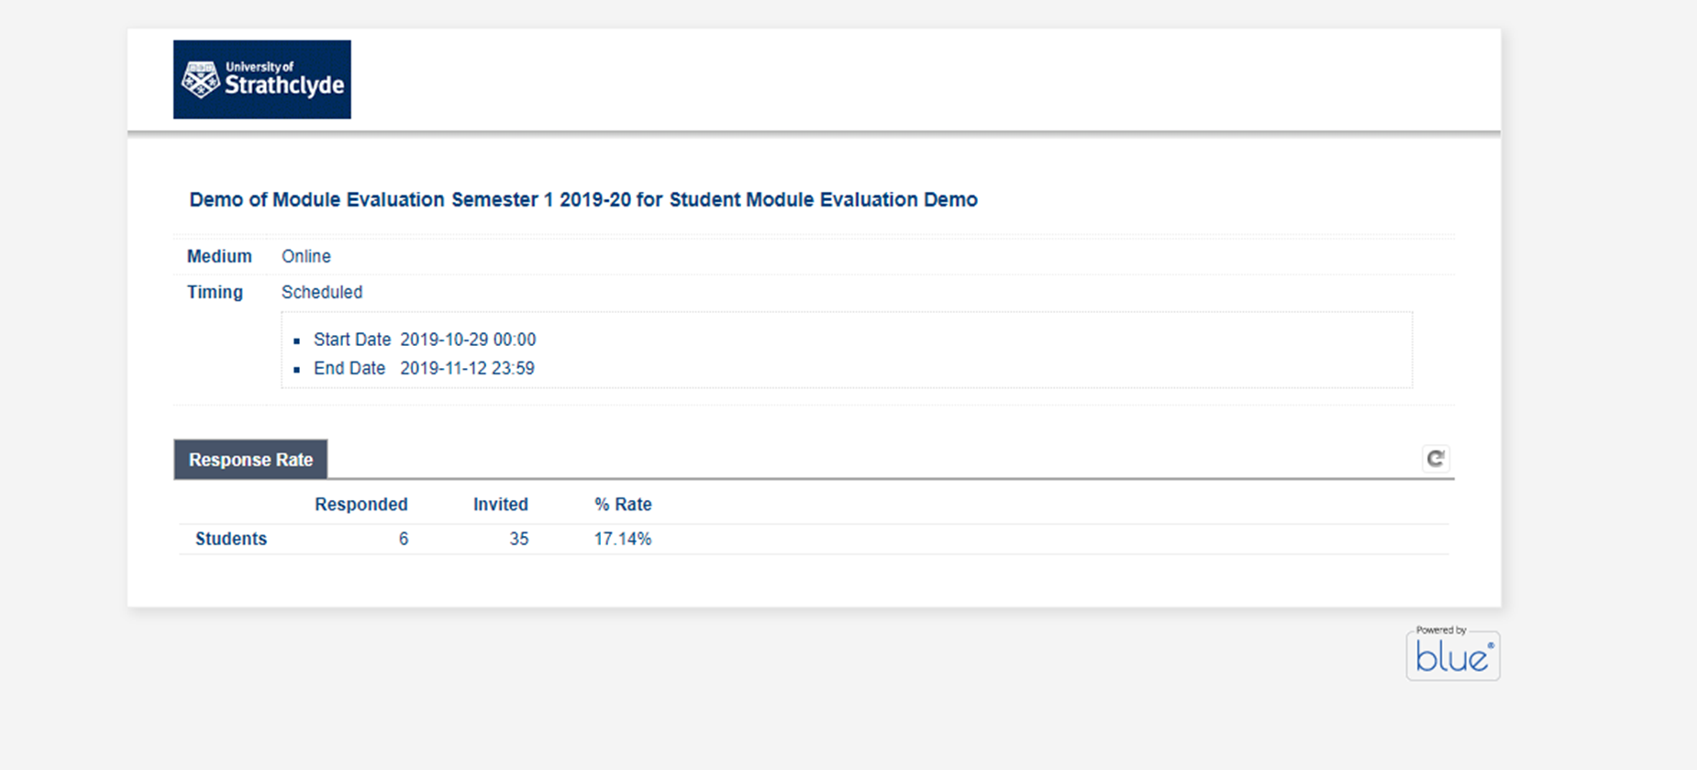
Monitoring response rates
You can see the start and end dates for the module evaluation survey window
The table will show the response rates for the evaluations
You will be able to refresh the response rates live in class if you wish by clicking the arrow button on the right hand side

Slide 11
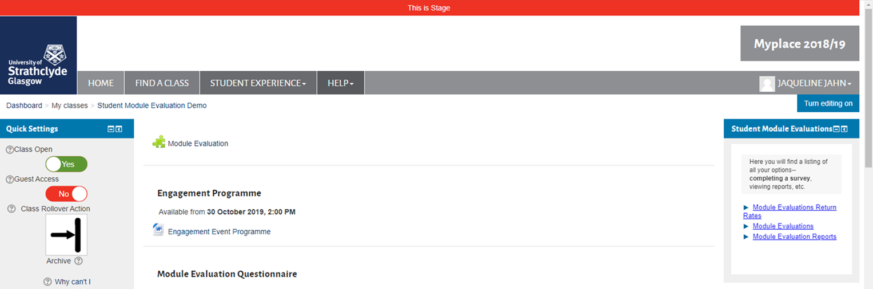
Accessing your module report
Once the evaluations have closed, a report will be generated automatically.
All teaching staff on a module will receive an email from the system inviting you to view your report(s).
You can also access your report by logging into your module Myplace site and selecting the Module Evaluation Reports link in the box on the right hand side.

Slide 12
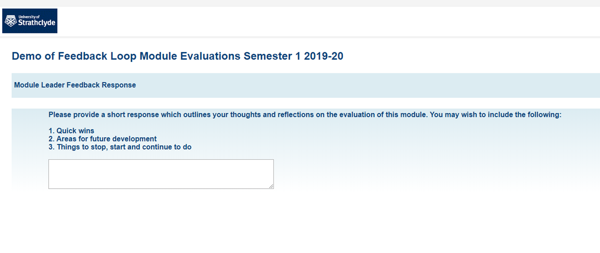
Review and provide comments
After you have received your report, the Module Leader (person who is designated Class Organiser in Pegasus) will receive an email invitation to add comments and reflections on the feedback received
These comments will appear in the student version of the report
Simply click on the link from the email to add comments (you will have multiple links if you need to comment on more than one module).

Slide 13
Using the Demo Site
This section gives instructions for using the demo site only

Slide 14
Pop-up in Myplace
To use see the student experience in our demo system:
Navigate directly to our demo Myplace page: https://stage.myplace.strath.ac.uk
Log in to Myplace using your own details
You should see a pop-up message inviting you to complete your evaluations (for the purposes of the demo teaching staff have been set up as students)
If the pop-up doesn’t appear or you have dismissed it, you can navigate to Student Module Evaluation Demo on the Myplace class site…
In the demo site you should see one link for Student Module Evaluation Demo

Slide 15
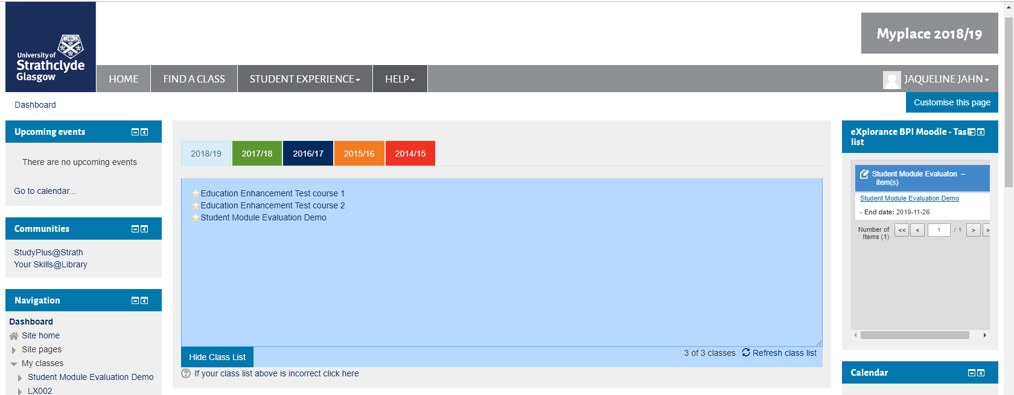
Completing the questionnaire: from the Myplace staging site
From the dashboard page of the Myplace staging site:
Click on the Student Module Evaluation Demo link to go to the demo class site
Then click on the Module Evaluation link in the right hand side block (as per slide 6)
Shortcut: You can also click on the link in the block on the right hand side to be taken straight to the survey
  Note: students will not see this option on their Dashboard page in Phase 1 – the module evaluation block will only appear on the module site page for the participating classes
Notes:
The example above also shows how students will access the link

Slide 16
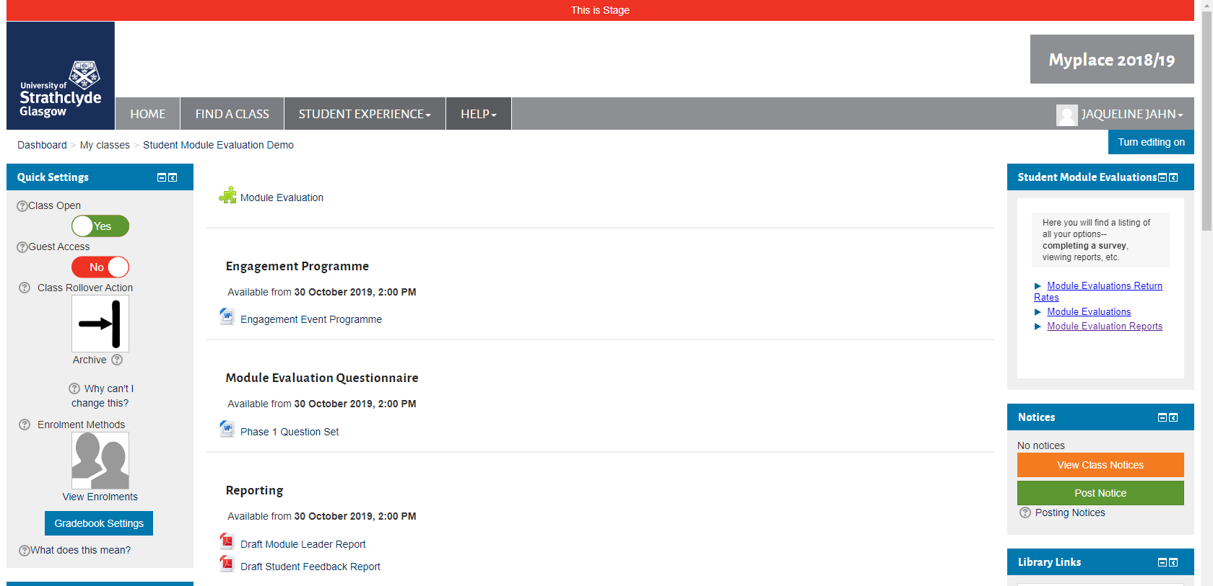
Example reports: Demo site
Navigate to the Student Module Evaluation Myplace site
Click on Module Evaluation Reports link in the box on the right hand side.
In the demo site you will see a message saying you have no reports at this time
You can view example reports for teaching staff and students under the Reporting section shown below
Please get in touch with the Module Evaluation project team if you have any feedback or thoughts to share

Slide 17
FAQ: Completing the survey
How will students access the module evaluation?
  Students will access module evaluation via Myplace. They will receive an email that directs them to Myplace where they can complete the evaluations.
  While the student still has module evaluations to complete, they will see a pop-up message when they log in.
  There will be another link to the evaluations from the module’s Myplace class site – see slide 6.
  The Navigation block also contains a link to the student’s evaluations – see slide 7.
What happens if students aren’t present in the class? / Teaching has finished for my class, will students still be able to complete the evaluation?
  If your teaching classes have already finished for the semester, you may wish to send a short message to students via a Myplace class notice to draw their attention to the other ways that they can complete their module evaluation.
  Students will be able to access module evaluations on the Myplace class site.
  They will also see a pop-up message when they log into Myplace containing links to any outstanding evaluations they have to complete.
What about response rates?
  We have found that the most effective means of encouraging students to respond is to complete module evaluations in class. Taking 10 minutes at the beginning of the class is more effective than trying to squeeze in time at the end.
  You can monitor response rates live and encourage / remind students to complete their evaluations throughout the evaluation window.
  We will also encourage completion through pop-ups and email reminders.

Slide 18
FAQ: Reports and closing the feedback loop
Who receives the reports?
  All teaching staff on a module will receive a report.
  The member of staff defined as the Course Organiser in Pegasus will also receive an email invitation to submit comments on the student feedback gathered during the evaluations.
  All teaching staff on the module will then receive a final version of the report which also includes the Course Organiser’s comments.
How do we closed the feedback loop with students?
  We know that it is really important to our students for teaching staff to provide a response to student feedback. This keeps them engaged in a dialogue to help us continually improve our learning and teaching experience and can be one of the greatest drivers in encouraging future participation in evaluations.
  As part of the evaluation process, every student will receive a summary report of the results, which will include the reflections and comments from teaching staff (as detailed above).
What do I have to enter in the comments for the student report?
  The comments and reflections don’t have to be particularly detailed, just one or two paragraphs in response to the feedback you have received in the evaluations.
  You may wish to address any significant themes that have emerged, and highlight any changes that you plan to make to the module either immediately or in the future.
  If there are changes that you are unable to make, you may wish to explain the reasons for this to help students understanding of the situation.
When will the reports be issued?
  In Phase 1, the evaluations will be open from 18-29 November 2019 inclusive.
  Reports will go to teaching staff on 9th December 2019.
  Comments will have to be completed by 9th January 2020.
  Reports will be issued to students on 13th January 2020.

Slide 19
Still got a Question?
If you have any further questions please contact the Module Evaluation team:
lorna.robertson.100@strath.ac.uk
jacqueline.jahn@strath.ac.uk
modules@surveys.strath.ac.uk

