Slide 1
Student Module Evaluation: Guide to Myplace Settings
September 2020

Slide 2
Module evaluation settings: Summary
Myplace allows you to select your preferences for module evaluation
You can do this while you are setting up the Myplace class site for the module
Each class site can be opted in (or out) in Quick Settings
After selecting whether the module runs for one or two semesters, there are 2 options to select for timings
Mid-semester evaluation window (currently Weeks 4-6)
End of semester evaluation window (currently Weeks 9-11)
Note that timings relate to the period that evaluations will be open for completion rather than the type of evaluation e.g. for short modules it is possible to do an “end of module” evaluation in the Mid-Semester window, similarly a longer 2-semester module could have a “mid-module” evaluation in an End of Semester window
If you choose a mid-semester evaluation, you have the choice of a short format questionnaire or the standard questionnaire
Caution!
Turning on the module evaluation for a Myplace class site will survey all of its associated class codes. Please check to ensure before saving your settings that students are not going to be surveyed multiple times for the same module.

Slide 3
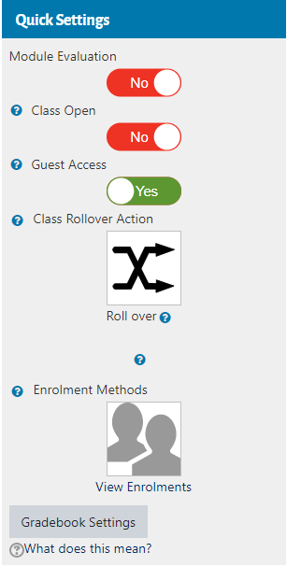
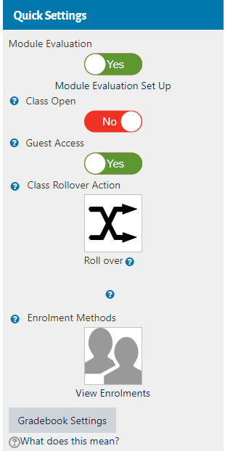
Opting in to module evaluation
When you log in to the Myplace class site, a Module Evaluation toggle will appear in the Quick Settings bar
Click link to set up
Slide the toggle to Yes and an additional link will appear to allow you to set preferences

Slide 4
Setting module timing
From the drop-down, select whether the module runs in Semester 1, Semester 2 or Both Semesters.
Next select when you want the module evaluations to take place
For one semester classes, select whether you want to run the evaluation in the middle of Semester window (Weeks 4-6), at the end of Semester window (Weeks 9-11) or at both Mid and End of Semester.
Note: this may be different to the timings of your module e.g. Mid Semester evaluation window might be the end of a short module
Two semester classes will show four options for dates in the Survey Period section underneath, therefore there is nothing to select in the ‘Survey at’ box.

Slide 5
Choosing the frequency of module evaluation: One semester classes
The survey period section will show options based on the module timing you selected
From the drop-down list, select the weeks in which you would like to conduct evaluations.
Evaluations can be open for 1, 2 or 3 weeks within the given windows.

Slide 6
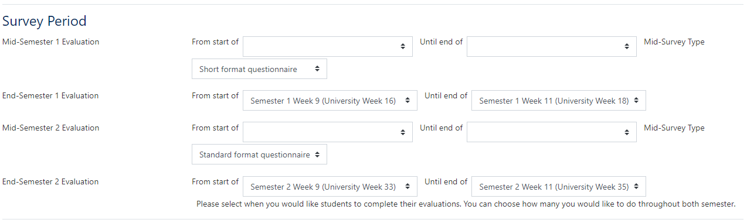
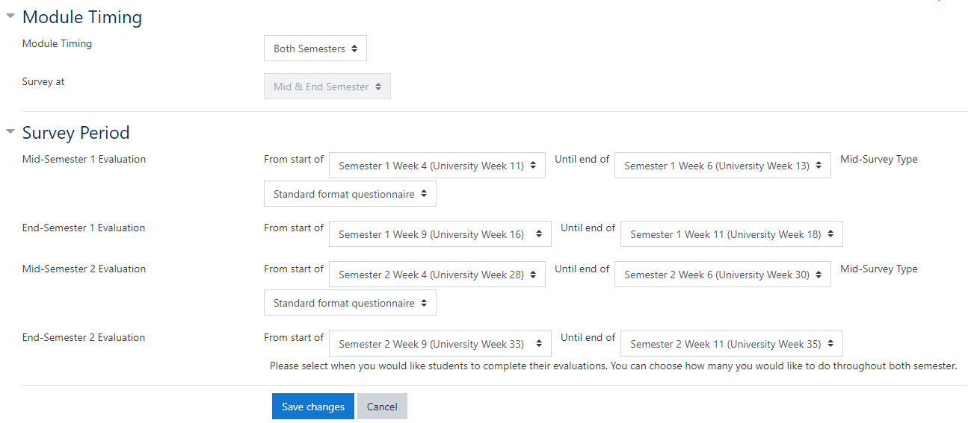
Choosing the frequency of module evaluation: Two semester classes
Example 1: Module evaluation selected for the end of Semester 1 and end of Semester 2
1
2
3
Example 2: Module evaluation selected for both mid-Semester and end of semester windows in each semester (i.e. 4 times throughout module)
4
Two semester classes will show four options for evaluation dates which can be customised in any combination preferred.
If you do not wish to survey in a particular window, simply leave the boxes blank.

Slide 7
Choosing Mid-Semester Questionnaire Format
For Mid-Semester evaluations, choose whether a short format or standard format questionnaire is required.
All End of Semester evaluations follow a standard format.

Slide 8
Submitting selections
When you have selected your preferences, click Save changes at the bottom of the page. You can go back into the page and amend your settings at any time.
Shortly before each evaluation window, there will be a temporary freeze where no further changes can be made before the evaluations. At the end of each evaluation period you will be able to go back in and change options for subsequent windows.

