Slide 1
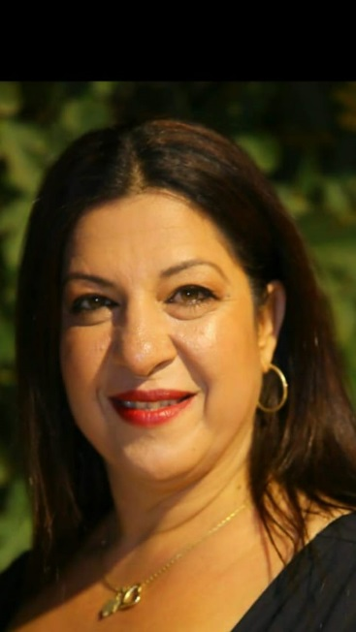
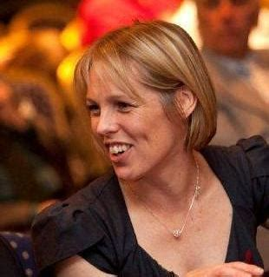


Managing Academic Industry Collaborations
2 pm, Thursday 20th June
John Anderson Building
Room 813
NPL has developed a flexible and dynamic approach to managing scientific and technological research as well as PhD models. This seminar explores new ways for industry and academia to work together. The challenges to collaboration and how those with an academic background can overcome these through culture, communication and working flexibly, will be discussed
With combined experience of over 30 years in academic, industry and not for profit environments, Linden Fradet and Leah Chapman will share knowledge, highlight pitfalls and offer advice.

