Slide 1


A plan of atomic and molecular
research at the National Fusion Research Institute(NFRI)
October 4, 2010
ADAS WORKSHOP
Mi-Young Song

Slide 2

I. Introduction of NFRI

Slide 3
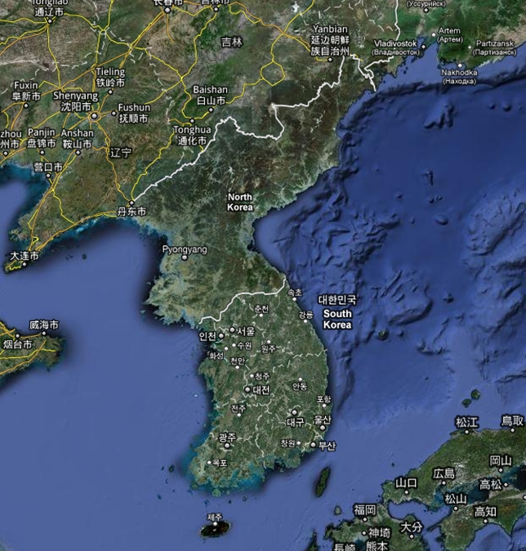
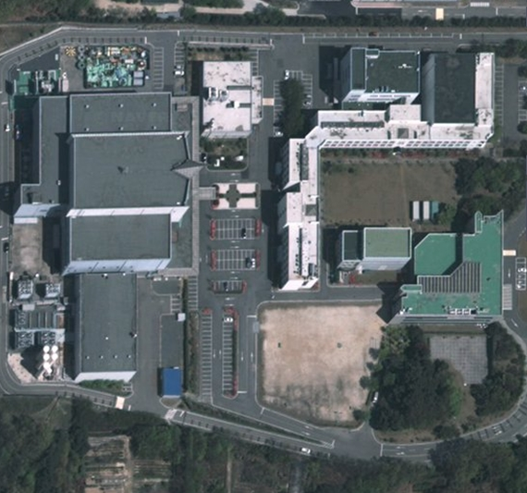
Location
NFRI

Slide 4
National Fusion Research Institute
Purpose
- Technology development for construction of Korean fusion reactors and commercialization of fusion energy as a world leader in fusion energy research and development
History
1995. 12. The master plan of KSTAR project was approved by national fusion R&D committee
1996. 01. The National Fusion R&D Center was established (in KBSI)
2002. 09. The ceremony for the completion of KSTAR experimental building was held
2005. 10. National Fusion Research Center (NFRC) was established
2007. 09. KSTAR construction will be finished
10. National Fusion Research Institute (NFRI) was established
2008. 07. KSTAR has successfully achieved its First Plasma
2008. 09. Dr. Gyung-Su Lee has been named the new President of the NFRI
2009. 09. KSTAR full fledged experiments Ceremony
2010. 03. Groundbreaking ceremony of the Convergence Plasma Research Center

Slide 5
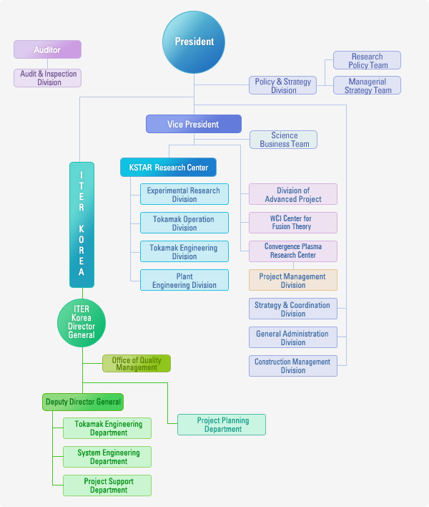
Organization of NFRI
Convergence plasma research
center
Plasma application technologies based on the specific properties of plasma.
The operating conditions for plasma can be in various environments from Ultra low to atmospheric pressure.
Plasma application technologies have been in application for pressure many industrial field such a BT,NT,IT,ET, and ST
Data center for plasma properties (DCPP)
- Plasma Simulation
- A+M data research
- Basic research for plasma processing

Slide 6
Data center for plasma properties
Making of national information resources on plasma properties by basic data
research to be applied to fusion and industry and provision of
infrastructures regarding design, operation and control technologies
Establish research and industrial support system throughout establishment of
web-based simulation system
Main
Contents
Ion
Impact
Heavy
Particle
Collision
Electron
Impact
Develop Application-Specific Standard Products for Many Customers
Integration-Evaluation-Compilation-Standardization-Dissimination
Provide advantages in time to device maker and assist in USER (industry, Institute, University)
Reaction
Rate
Coefficient
Plasma
Database
Integrated Device Manufacturer
Simulation
Software
Documentation
Visualization

Slide 7
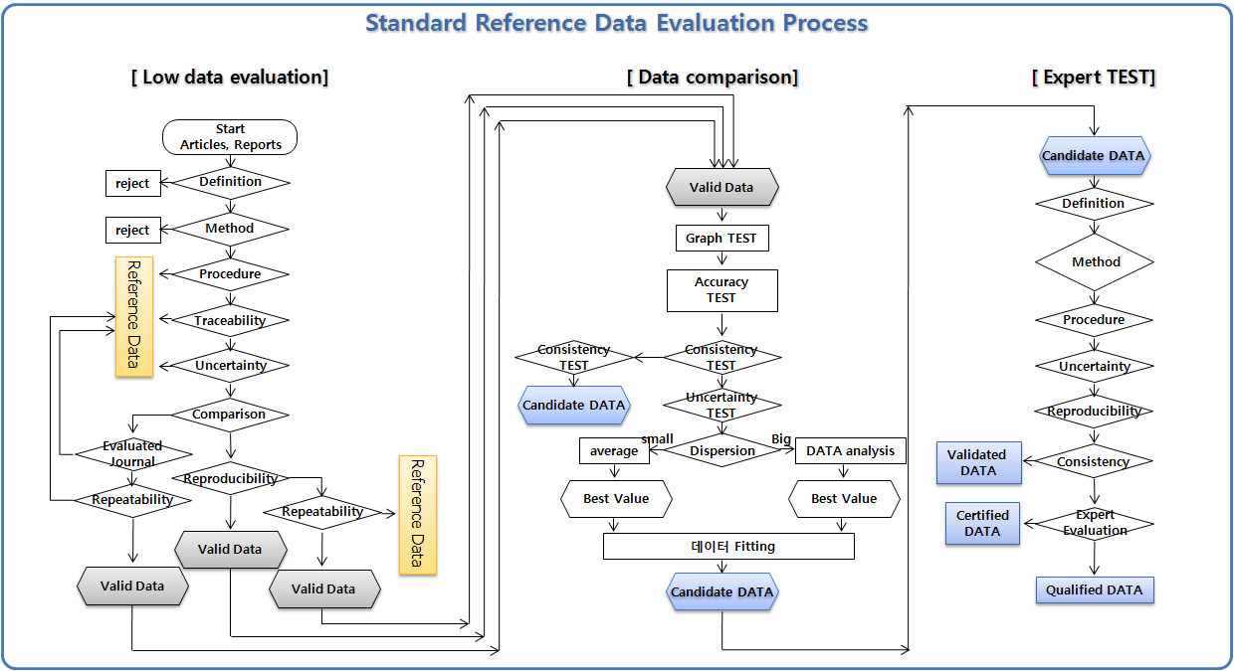
Standard Reference Data
Synthesis
Evaluation
Compilation
Standardization
Maintenance
Notes:
참조포준 :
플라즈마 소스, etching, DEPOSITION GAS, 26개의 분자 데이터에 대한 데이터 평가를 4년 동안 하였음.
We can evaluate 26 molecules collision data using industry field for 4 year
Period: 2006-2009
DB record: 145,517 record
Number of A&M : 475
Journal : 30
Electron impact: 85992
Photon impact:
Heavy particle impact:
H2,N2,O2,Ar,Xe, CF4, C2F6, C3F8, C4F8, CF3I, CH3F, CCl2F2, SF6, SiH4,Si2H6, SIF4

Slide 8
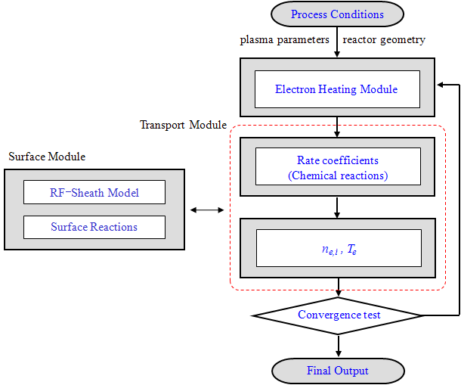
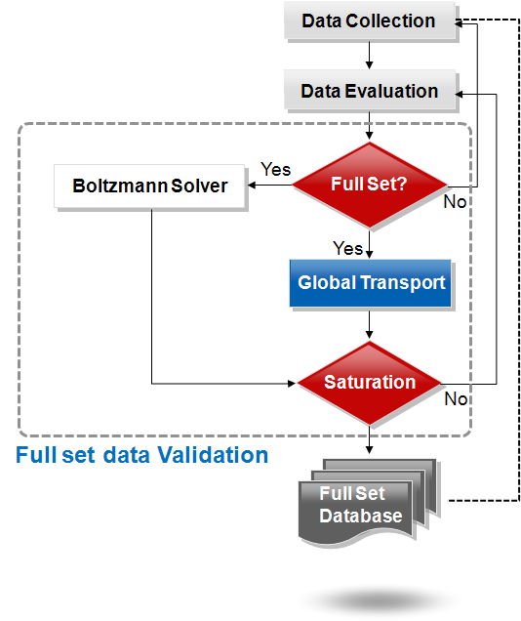
Development of Simulator
Verification of full set using Reference Cell
Notes:
081219->
ASIA-PACIFIC ATOMIC DATA NETWORK (APAN)
A Network for the Gathering and Dissemination of Collisional Data of Relevance to Plasmas, Discharges, Materials and Bioscience
Sponsored by the Korean National Fusion Research Institute (NFRI)
(DRAFT STATEMENT of INTENT)
The Asia-Pacific Atomic Data Network (APAN) was established in response to the realisation that many such data centres that have existed around the world are closing, or winding back their operations, despite what appears to be an increasing need and use for atomic data. It is also clear that the number of the international laboratories involved in the measurement or calculation of atomic collision parameters is also rapidly reducing. To some extent the Asia-Pacific region is an exception to this international trend, and there are still strong research activities, and collaborations, in the measurement and application of fundamental collision properties throughout our region. It was thus felt important to organise the existing activities in the Asia-Pacific region and to use the auspices of the Data Centre at NFRI as a focus for our activities.
The anticipated role of the Network will be to
Conduct and promote the measurement and calculation of atomic data of relevance to applications in discharge and plasma physics, materials and biomedical science
Provide a mechanism for the efficient compilation, assessment, and critical evaluation of atomic and molecular data
Assess emerging areas of need for atomic data
Provide a strong regional focus on collaborative research in atomic and molecular physics
Provide a link between researchers in A&M Physics and potential end-users of data
The Data Network will be coordinated through the existing Data Centre at NFRI, who will provide secretarial and other support in the initial phase of establishment of the Network. It is proposed that there should be strong links with other atomic data centres and networks with a view to establishing an open platform of access to important atomic and molecular data.
The Network will initially be managed by a Network Committee which will be supported by an Advisory Committee of 5-6 individuals which is drawn, ideally, from senior scientists in the field. The proposed membership of the Network Committee is
Network Committee :
S. J. Buckman (Chairman, Australian National University Australia)
H. Tanaka (Sophia University, Japan)
E. Krishnakumar (Tata Institute, India)
V. P. Shevelko (Lebedev Institute, Russia)
H. Cho (Chungnam National University, Korea)
J.-S. Yoon (Secretary, National Fusion Research Institute, Korea)
Advisory Committee : 5-6 people
H. Tawara (Japan)
Y. Itikawa (Japan)
T. J. Kim (Korea Institute of Science and Technology Information)
--> not fixed now, but will be include some people from KISTI.
The proposed structure of the Data Network is outlined in the schematic below.

Slide 9
Ⅱ. Activities of KSTAR

Slide 10
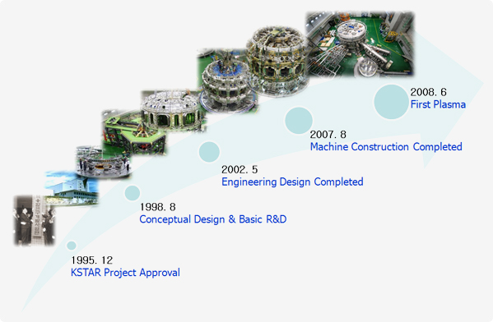
Brief History of KSTAR Operation
Operation goals
- To develop a steady-state-capable advanced superconducting tokamak.
- To establish the scientific and technological base for an attractive fusion reactor as a future energy source
Operation history
Notes:
•2007. 9. Device construction completed
•2008. 3. 1stcampaign begins
•2008. 4. SC magnet cool-down (4.5 K) w/o cold leak
•2008. 5. TF magnet operation up to 15 kA without quench (1.5 T)
•2008. 6. First plasma up to 107 kA (2ndharm. ECH 84 GHz, 1.5 T)
•2009. 8. 2ndcampaign begins with SC magnet cool-down
•2009. 11. Plasma current up to 320 kA (2ndharm. ECH 110 GHz, 2 T)
•2009. 11. TF magnet charged up to 36 kA (3.6 T in R=1.8 m)
•2010. 6. Completion of in-vessel components upgrade
•2010. 6. 3rdcampaign begins (evacuation & leak test)

Slide 11
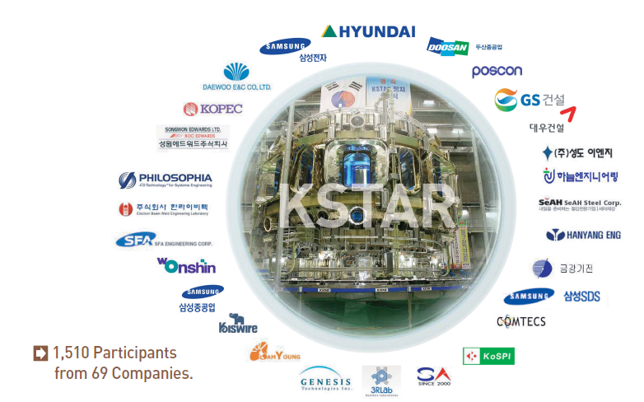
KSTAR Parameters
Parameters | KSTAR | ITER
Major radius(m) | 1.8 | 6.2
Minor radius (m) | 0.5 | 2.0
Elongation | 2.0 | 1.7
Triangularity | 0.8 | 0.33
Plasma volume(m3) | 17.8 | 830
Plasma surface area (m2) | 56 | 680
Plasma cross section(m2) | 1.6 | 22
Plasma shape | DN,SN | SN
Superconductor | Nb₃Sn | Nb₃Sn
Toroidal field(T) | 3.5 | 5.3
Plasma current (MA) | 2.0 (중형) | 15 (대형)
Auxiliary heating (MW) | 30 (40) | 110
year | 2007 | 2015
KSTAR 사진

Slide 12
KSTAR operation & experimental plan
Main
Goal
Research
Subject
07
08
09
10
11
12
13
14
15
16
17
18
19
20
21
22
23
24
25
year
Phase I
Phase II
Phase III
Phase IV
SC Tokamak operation technology
Steady-state operation
High beta, AT operation
Steady-state AT
First plasma
(100 kA, 100 ms)
SC Tokamak operation technology (3.5 T 급 자장)
D-shaped plasma(1 MA 급 D-shaped plasma)
H mode achievement
Collaboration for operation
Long pulse operation (t _{pulse} > 100 s]
AT operation tech
[P _{heat} < 20 MW )
Collaboration for steady-state operation
ITER Pilot device operation
Long pulse operation (t _{pulse} > 300 s]
Stable AT operation [P _{heat} < 20 MW )
ITER Satellite operation
Collaboration for advanced research
High beta AT mode & long pulse
장시간 운전기술
Reactor material teat [divertor, Blanket]
1st plasma
1MA
D-D reaction
100 s
1E8 K
3E8 K
Notes:
Phase 1 (2008~2012)
Obtain the baseline operation technologies for superconducting tokamak
Basic performance test of superconducting tokamak
Reproducing existing tokamak operation modes (including H-mode) in Short Pulse
Basic performance test of auxiliary systems for high performance, long pulse operation
Phase 2 (2013~2017)
Develop long pulse plasma operation technologies
Long pulse operation of existing tokamak modes (up to 300seconds for H mode)
Realization of high performance AT mode under moderate power & magnetic field
Perform as an ITER Pilot Device
Phase 3 (2018~2022)
Develop high performance, high efficiency AT mode technologies
Long pulse operation of AT mode under moderate heating power
Realization of high performance AT mode under high power & moderate magnetic field
Performance as an ITER Satellite Device
Phase 4 (2023~2025)
Test of relavant prior arts for DEMO
Realization of long pulse operation for high power AT mode
Test of DEMO related prior arts

Slide 13
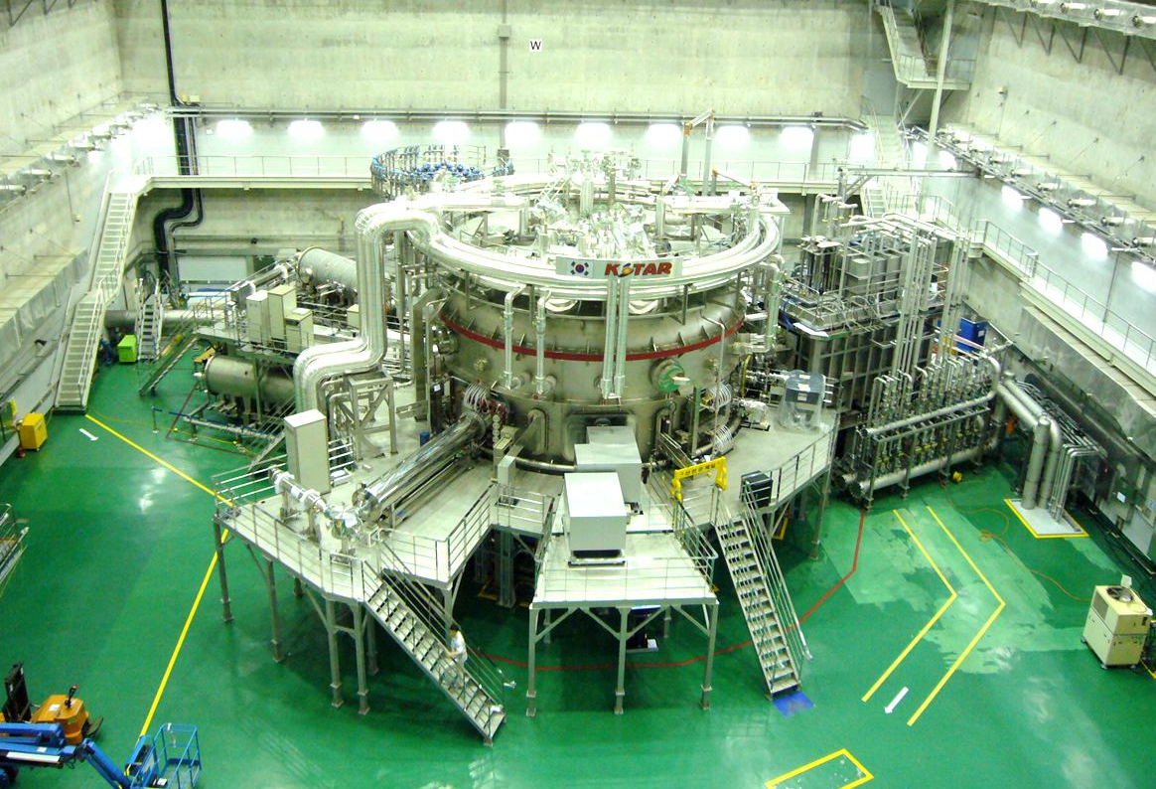
Diagnostic Systems for 2010 Campaign
XICS (radial)
CES
Recip. Langmuir Probe
Fast-ion Loss Detector
Thompson
Soft X-ray /
Fast frame TV / IRTV image Bolometer
Ellipsometry
Resistive Bolometer
ECE (112 ~ 192 GHz)
Visible spectroscopy
Hα / Filterscope
Hall Probes
Tangential XICS
Hard X-ray
neutron
mm-wave interferometer
Reflectometer
Glow discharge
ECEI

Slide 14
CES System in KSTAR
KSTAR CES system specification
Name | Target for 2010
Time resolution | 10 ms (100 Hz)
Spatial resolution | 10 cm (Core), 5 cm (Edge)
Ion temperature range | 100 eV ~ 10 keV
Toroidal velocity range | 4 km/sec ~ 100 km/sec
Accuracy | 10 %
System location | Active CES – M port, Backbround CES – A port
No. of Channels | 8 points
Spatial points | R= 1800, 1900, 2000, 2100, 2150, 2200, 2250, 2300 (mm)
NBI beam species | Deuterium
NBI beam energy | Max. 80 keV
NBI beam power | Max. 1.0 MW

Slide 15
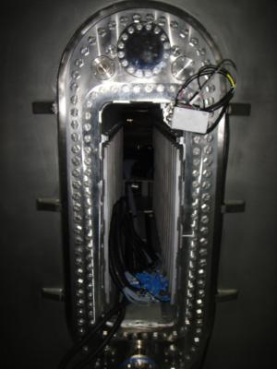
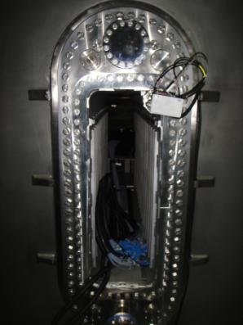
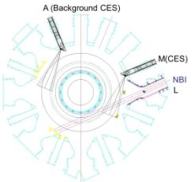
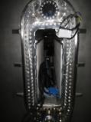
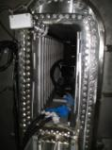
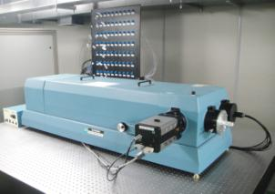
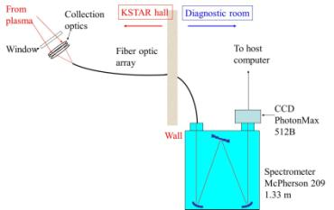
CES System in KSTAR
KSTAR CES System
Active CES
on M cassette
Background CES
on A cassette
Spectroscopy system for KSTAR CES
KSTAR CES system layout
KSTAR CES and background systems were installed successfully for the 2010 experiment. The best lenses, optical fibers, cassette shutters, connection junction boxes, CCDs, and spectrometers were selected.
KSTAR CES data acquisition system

Slide 16
Spectrum of CES
KSTAR plasma parameter
Name | Target for 2010
Time resolution | 20 ms (100 Hz)
Magnetic field | 2T
Fuel gas | D₂
Power | ECH perionization + Ohmic heating 110GHz, 330kW(-60ms-100ms)0
Shot number : 3237

Slide 17
Summary and future Plan of CES measurement
KSTAR CES will use background methods to measuring the ion temperature and toroidal rotation velocity profiles for this campaign.
17 channels – background CES (8), active CES (8), calibration (1)- are used to obtain radial profiles of ion temperature and rotation velocity
The wavelength (CVI 5292Å(n=8-7)) and intensity calibration for each radial position were finished.
The spectrum analysis tools study based on Atomic Data will be start.
- To distinguish species inside measured spectrum .
We has interest in developing physics program on impurity study.

Slide 18
III. Activities of ITER Korea

Slide 19
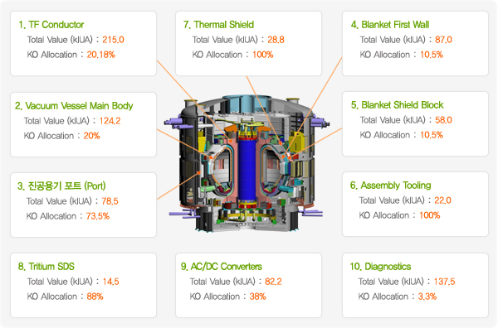
10 procurement item of the ITER Korea

Slide 20
ITER VUV Spectroscopy
Impurity Species Monitoring:
The plasma facing materials in ITER are beryllium-coated copper in the first wall, and carbon and tungsten in the divertor. To effect a radiative divertor, and possibly for diagnostic use, noble gases such as neon, argon and krypton will be injected.
Real-time impurity monitoring of these elements must be obtained continuously for physics reasons, but also for the first-wall protection (Cu spectral lines would imply damage).
The absolute quantity of the species as well as their rate of increase is required.
10 ms time resolution is required to follow intentional shape changes.
Elements which may be abundant in the ITER plasma:
  First wall materials: Be, Cu (First wall), C, W (Divertor)
  Fuel: H, D, T
  Fusion product: He
  Seeded impurities: N (ELMs control), Ne, Ar,
  Kr (Radiative divertor)
  Structural materials: Cr, Fe, Ni, …
  Others: Li, O, Al, Si, Zr, Mo, …
Notes:
20
사업기획·예산 관련 (국문 - 대정부·국회 보고용)

Slide 21
Impurity Transport Study Plan of KODA
Impurity modeling (or transport) codes based on Atomic Data numerically calculate the evolution of the impurity densities in time, space, and ionization states in ITER.
KO has interest in developing physics program on impurity study of ITER and the POSTECH is supporting ITER Korea (KODA) in impurity transport study.
The responsibility for preliminary and final design will be handed over to the KODA.
The POSTECH has launched the calculation of the one-dimensional time-dependent radial profiles of impurity ions for transport study in Tokamak using the MIST (Multiple Ionization State Transport) Code.
  Expand the impurity study to ITER relevant analysis through international collaboration.
Notes:
21
사업기획·예산 관련 (국문 - 대정부·국회 보고용)

Slide 22

http://dcpp.nfri.re.kr

