Slide 1
Real-time Soft Xray for impurity density profiles
Fast Ni and Fe density estimation using Soft Xray measurements in Tore Supra: preliminary study
D. VEZINET, D. MAZON, D. CLAYTON, R. GUIRLET, M. O’MULLANE, D. VILLEGAS
Fusion Science and Technology, accepted
ADAS workshop| Didier VEZINET
25th september 2012

Slide 2
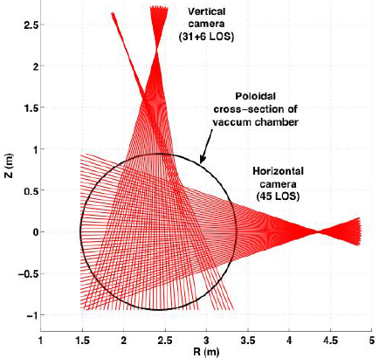
Operational objective
Objective :
Give a fast estimation of the total density distribution a given impurity in the plasma (e.g. : injection)
Means:
SXR diagnostics: (spatial resolution ≈ 5cm)
Poloidal tomography :
(82 lines of sight, currently available, absolutely calibrated)
2D local absolute value of SXR emissivity
Assumption:
Low dependency of the SXR cooling factor on transport coefficients ?
Measured
Estimated

Slide 3
Some observations…
SXR data is integrated spectrally (but is usually spatially localized thanks to tomographic reconstructions)
e.g. : MFI on Tore Supra [1], allows for reconstruction of poloidal asymmetries [2]
Transport coefficients for simulations have to be fitted using minimisation algorithms that cannot always guarantee the solution is not a local minimum
Some previous transport studies during impurity injections suggest that in some configurations and for some impurities, the ionisation equilibrium and/ or the cooling factor might depend only weakly on transport coefficients in the Soft Xray (SXR) range [3-5].
[1] M. Anton et al., Plasma physics and controlled fusion, vol. 38, p. 1849, 1996.
[2] D. Mazon et al., Review of Scientific Instruments, vol. 83, no. 6, p. 063505, 2012.
[3] R. Dux et al., Nuclear Fusion, vol. 39, p. 1509, 1999.
[4] T. Pütterich et al., Plasma Physics and Controlled Fusion, vol. 50, p. 085016, 2008.
[5] M. Sertoli et al., Plasma Physics and Controlled Fusion, vol. 53, p. 035024, 2011.
S = atomic species Z = atomic number z = ion charge

Slide 4
Cooling factor estimation
(H1) Local ionisation equilibrium
Stronger
(H2) Cooling factor not affected by transport
(H3) Ionisation equilibrium is approximated with rough ‘standard’ estimation of (D,V)
More general
(H4) Cooling factor can be approximated by rough ‘standard’ estimation of (D,V)
Tabulation ?
Genetic algorithm ?
Neural network ?
Rough ‘standard’ estimation of (D,V)

Slide 5
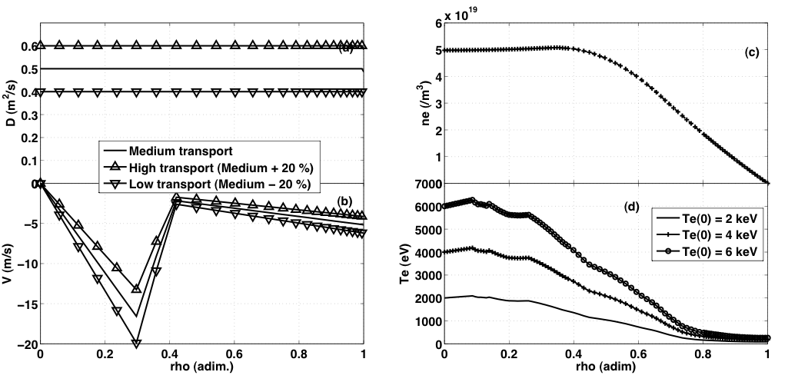
Preliminary study: simulated Fe injection
3 tranport scenarii
3 Te profiles (TS-inspired)
Simulation run on STRAHL, with CHIANTI atomic data, stationary state after Fe injection (no exchange through the LCFS after the injection)
The author would like to thank Daniel Clayton (Johns Hopkins University, Baltimore, MD, USA) for his kind support and help with these simulations

Slide 6
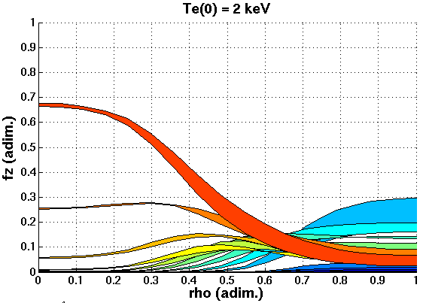
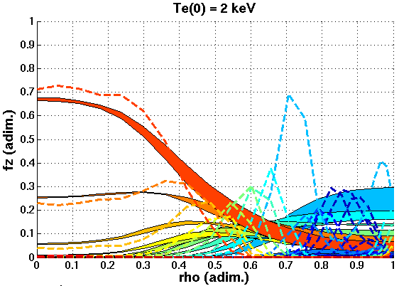
Preliminary study: simulated Fe injection
(H1) ?
(H3) ?
The author would like to thank Daniel Clayton (Johns Hopkins University, Baltimore, MD, USA) for his kind support and help with these simulations

Slide 7
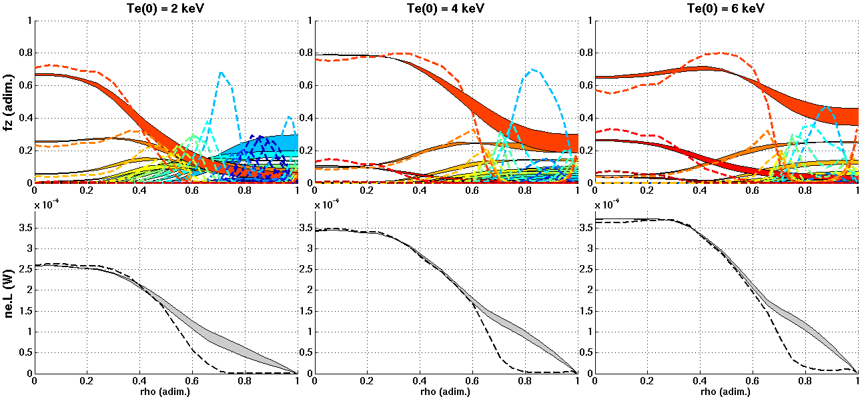
Preliminary study: simulated Fe injection
(H1) ?
(H1) ?
(H1) ?
(H3) ?
(H3) ?
(H3) ?
(H2)
(H2)
(H4)
(H2)
(H4)
(H4)
0,1 - 0,2 ≈ rho_{H1} < rho_{H2} < rho_{H3} < rho_{H4} ≈ 0,8 - 1 ?
The author would like to thank Daniel Clayton (Johns Hopkins University, Baltimore, MD, USA) for his kind support and help with these simulations

Slide 8
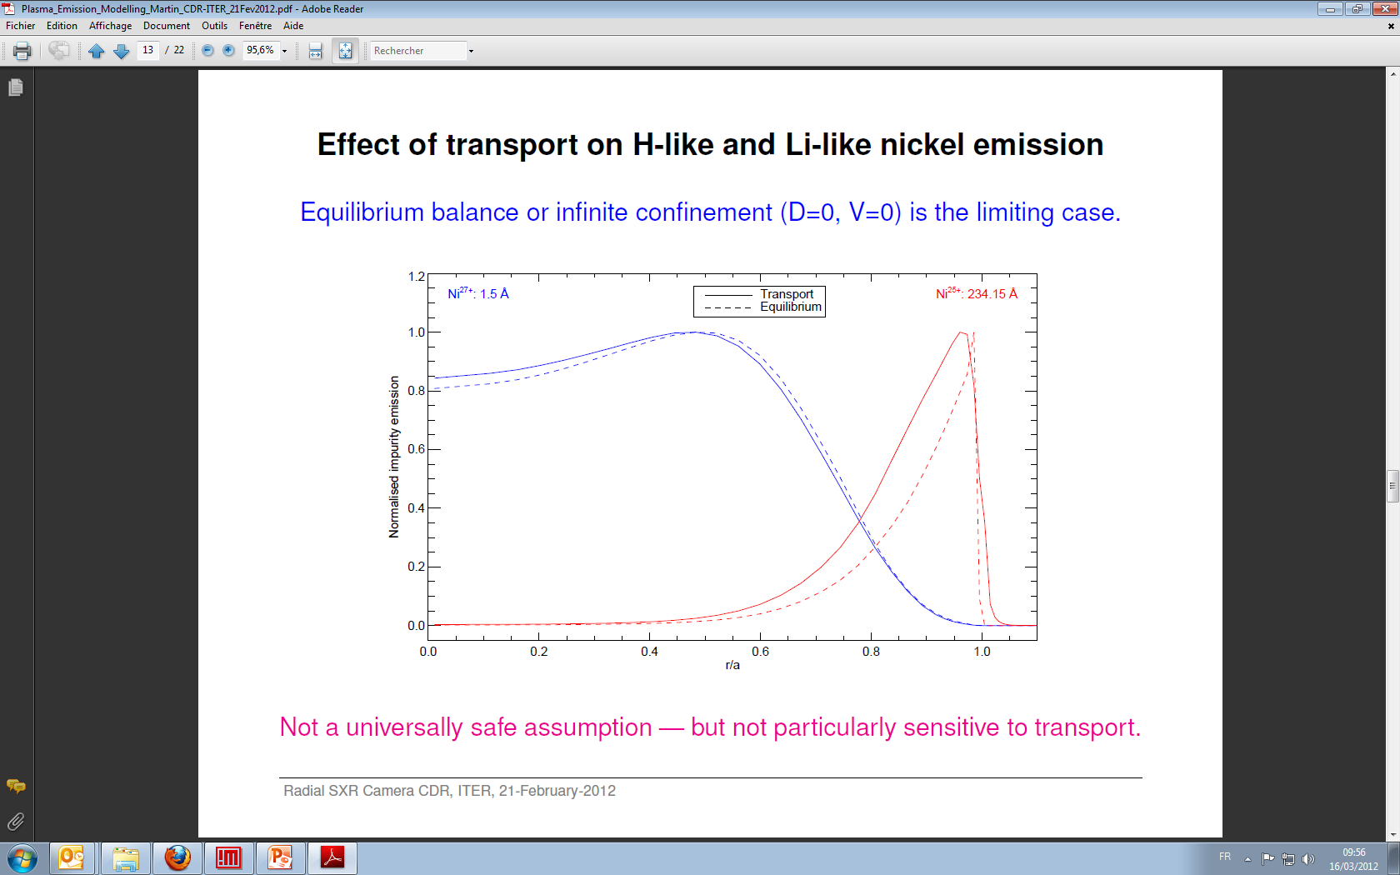
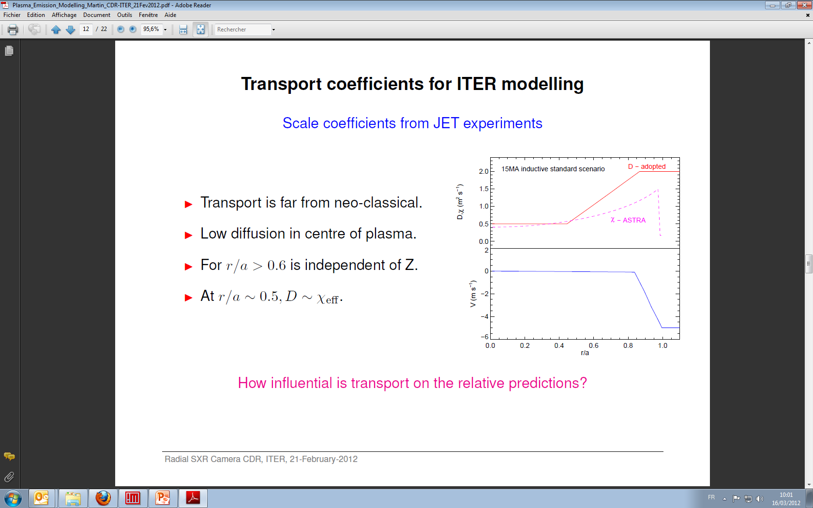
Simulated Ni injection on JET-like, ITER H-mode plasma
JET-like transport coefficients [6]:
Courtesy of Martin O’Mullane*
ITER-like Simulation run on SANCO, with ADAS atomic data, stationary state with Ni constant influx => stationary state, with flat ne profile
Slide 13/22 of CDR, ITER, 21st, February 2012
* M. O’Mullane, University of Strathclyde, Glasgow UK
[6] C. Giroud et al., Nuclear fusion, vol. 47, p. 313, 2007.

Slide 9
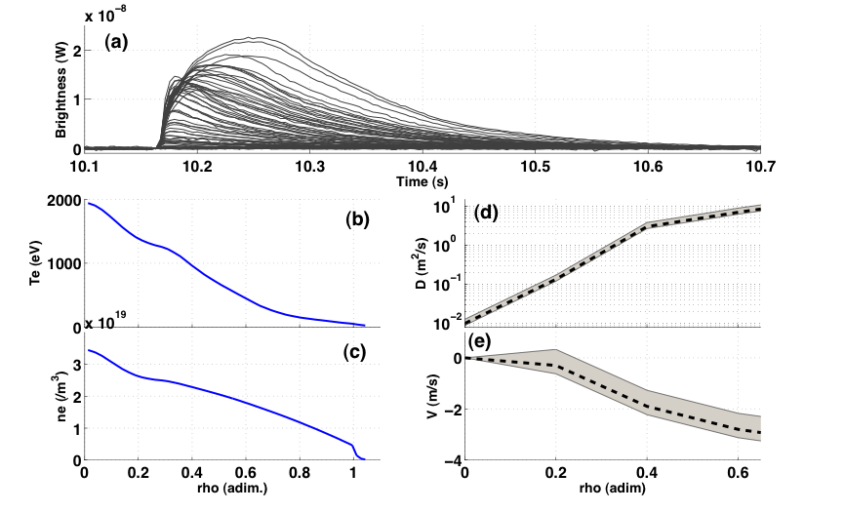
Experimental ni injection on Tore supra
Application: Ni trace injection in Tore Supra (TS # 40801)
Impurity transport studied in detail [7]
D and V assumed to be stationary, equal for all ionisation stages
D and V profiles were found iteratively (genetic algorithm) to best fit experimental data (assuming poloidal symetry).
Experimental inputs : Te (ECE) & ne (reflectometry)
Experimental constraints : SXR (line-integrated, relative constraint), Prad (bolometry, absolute constraint), spectroscopy, ...
+/- 20 %
[7] D. Villegas, R. Guirlet et al., Physical Review Letters, vol. 105, no. 3, Jul. 2010.

Slide 10
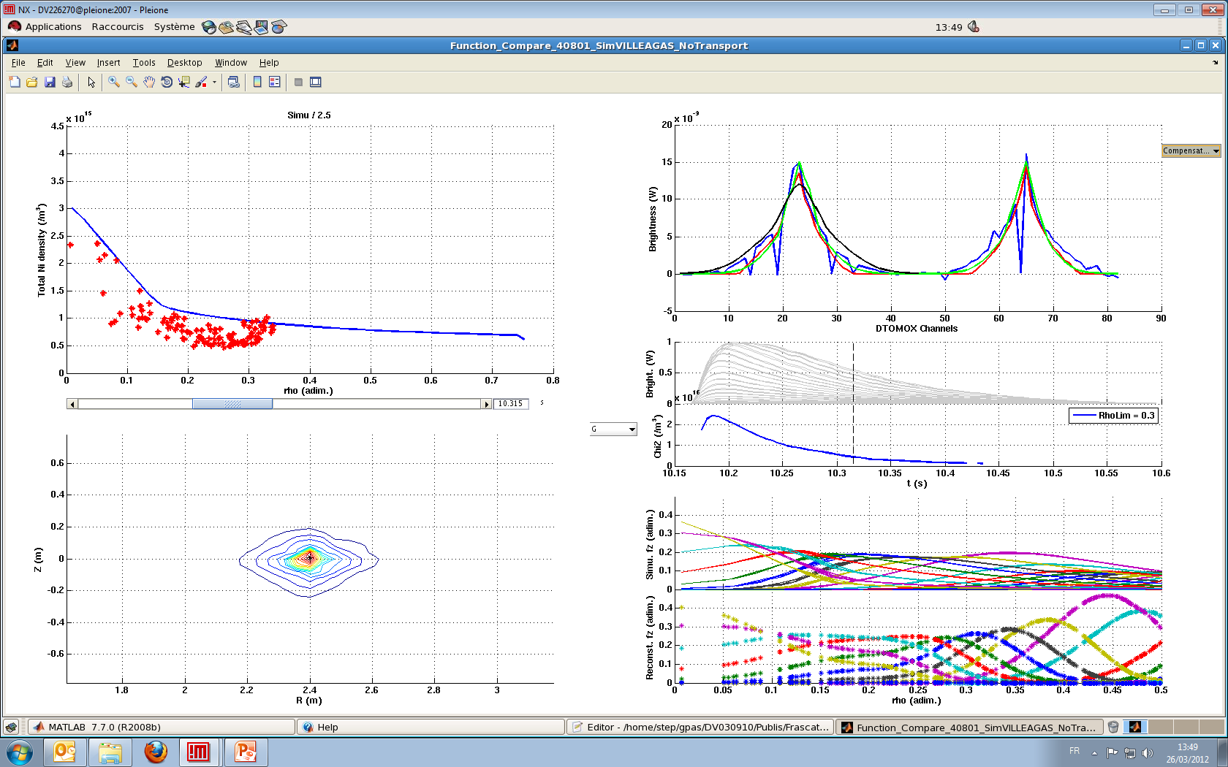
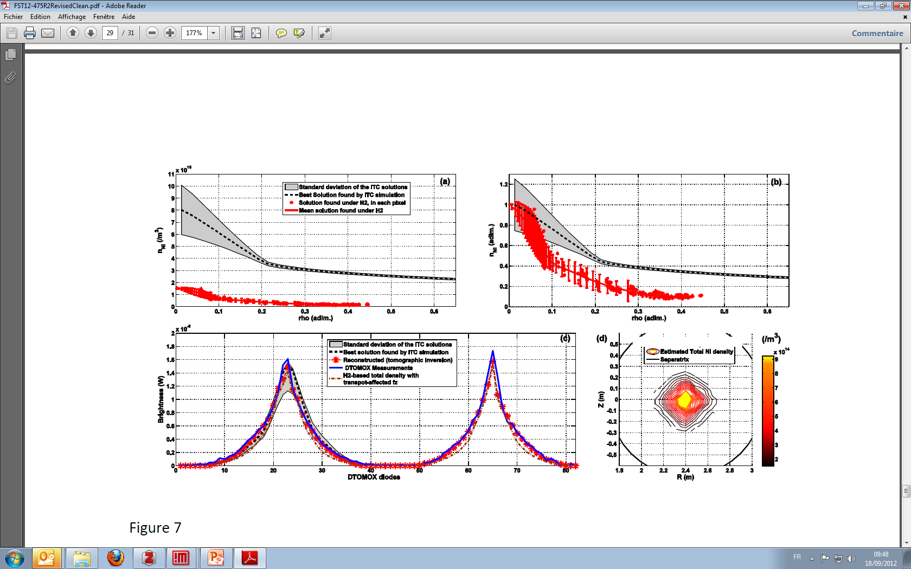
Experimental ni injection on Tore supra
Same order of magnitude of n_{S} (ratio 2,5 => cross calibration)

Slide 11
Experimental ni injection on Tore supra
(H4) satisfactory ? (error bars based on discrepancy to measurements)
Same order of magnitude of n_{S} (ratio 2,5 => cross calibration)
Similar normalised density profile (though more peaked)
Brightnesses : difficult to conclude, (line integrated)
=> Only horizontal camera used by transport studies
=> Promote the use of reliable tomographic inversions
(H2)
Scattering = uncertainty of the tomographic reconstruction
(H4)

Slide 12
Conclusions
Preliminary but encouraging results have been obtained that add up to previous observations by other authors.
(H1) might be valid in some cases, but generally inside a (very) limited central region of the plasma.
Our approach only requires more general assumptions, concentrate on (H2), (H3) and/or (H4) ?
More simulation are needed, with other impurities and transport coefficients as realistic as possible.
The use of spatially localised data (emissivity provided by reliable tomographic inversion) is prefered, and the importance of calibration [8-9] (relative for density profile shape and absolute for absolute density values) is emphasized. In particular, cross calibration between several diagnostics is seen as a key factor to enhance confidence in the results.
Reliable tomographic inversions also help diagnose poloidal asymetries [10] and could provide 2D maps of the total density, potentially in real-time in a near future.
[8] D. Mazon et al., Review of Scientific Instruments, vol. 79, no. 10, p. 10E321, 2008.
[9] D. Pacella et al., Review of Scientific Instruments, vol. 79, no. 10, p. 10E322, 2008.
[10] D. Vezinet et al., Fusion Science and Technology, vol. accepted.

Slide 13
DSM
IRFM
STEP
Thank you for your attention
Commissariat à l’énergie atomique et aux énergies alternatives
Centre de Cadarache | 13108 Saint Paul Lez Durance Cedex
T. +33 (0)4 42 25 62 25 | F. +33 (0)4 42 25 26 61
  Etablissement public à caractère industriel et commercial | RCS Paris B 775 685 019

