Slide 1
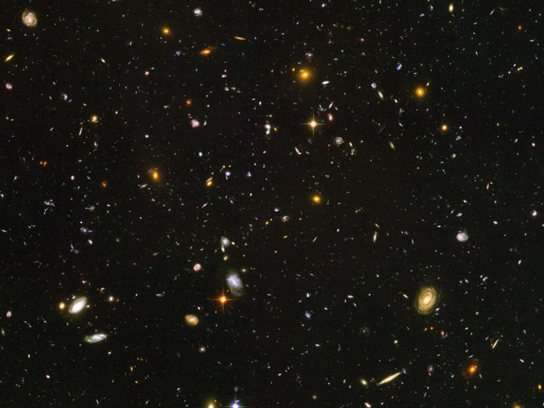
Astronomy
Observational, not experimental
Photos of objects
Spectrum

Slide 2
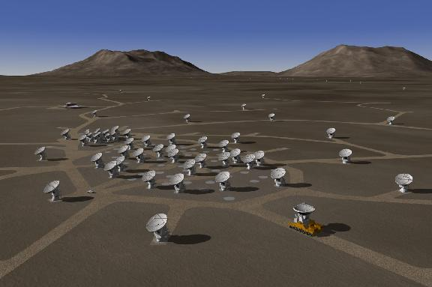
Notes:
ALMA

Slide 3
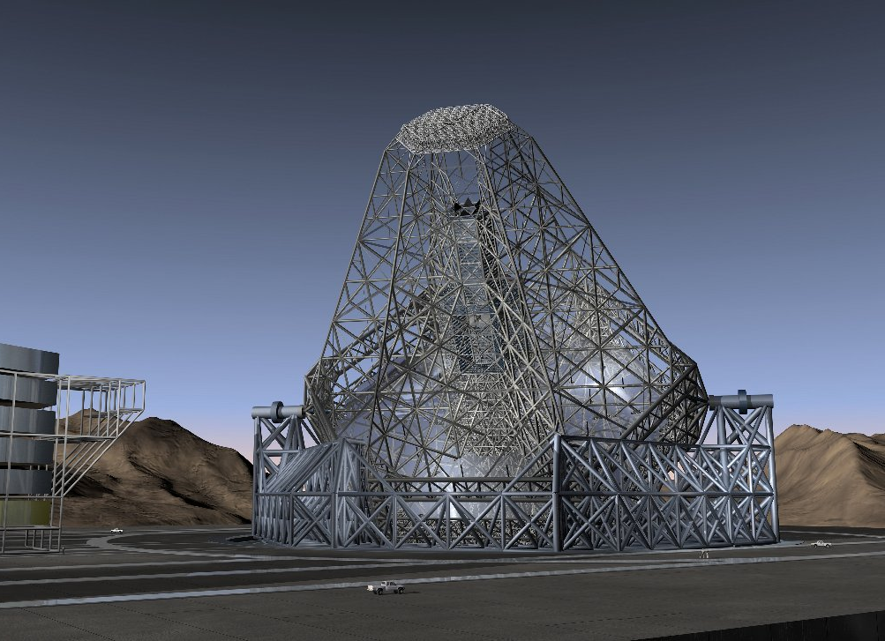

Slide 4
A non-equilibrium gas
Gas emitting spectrum has a very low density, exposed to a range of radiation fields and particles
Populations of levels, ionization, spectrum, determined by many micro-physical processes
Not characterized by a single temperature

Slide 5
H, He rich, some O, C, N, Fe etc

Slide 6
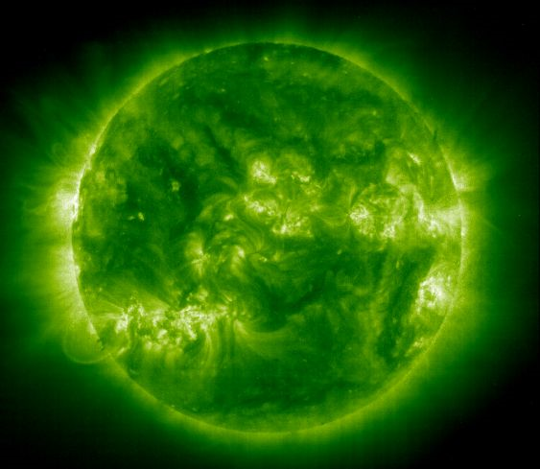
Solar corona
Collisional equilibrium
kT ~ iP
Fe XII

Slide 7
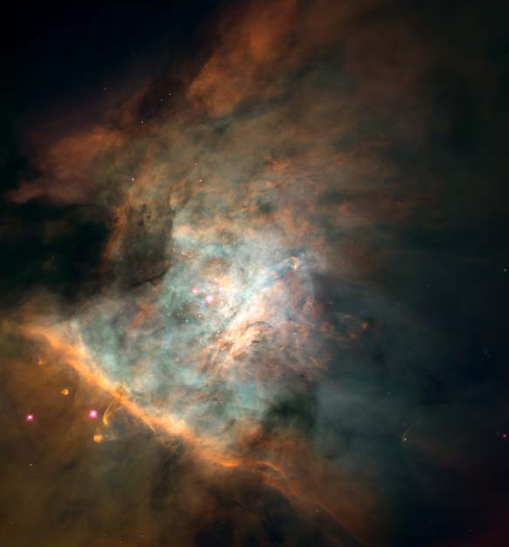
Notes:
Nick Abel

Slide 8
Stellar SED

Slide 9
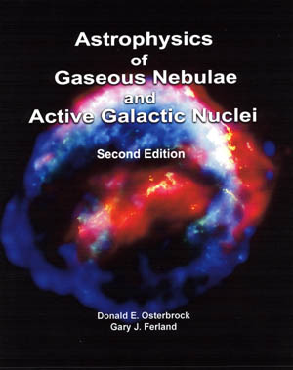
Photoionization Equilibrium
energetic radiation interacts with surrounding gas
photoionization
photoelectrons heat free electrons
electrons excite heavy elements
collisionally excited line cooling
free electrons recombine
recombination lines

Slide 10
Cloudy
Follows the detailed microphysics, with most processes treated at elementary level
All stages of ionization of the lightest 30 elements, 100+ molecules
2.7 K ≤ T ≤ 10¹⁰ K
10⁻¹⁰ ≤ n ≤ 10¹⁵ cm⁻³
Continuously maintained
Fully open source, at www.nublado.org

Slide 11
Ferland, G.J., 2003, ARA&A, 41, 517

Slide 13
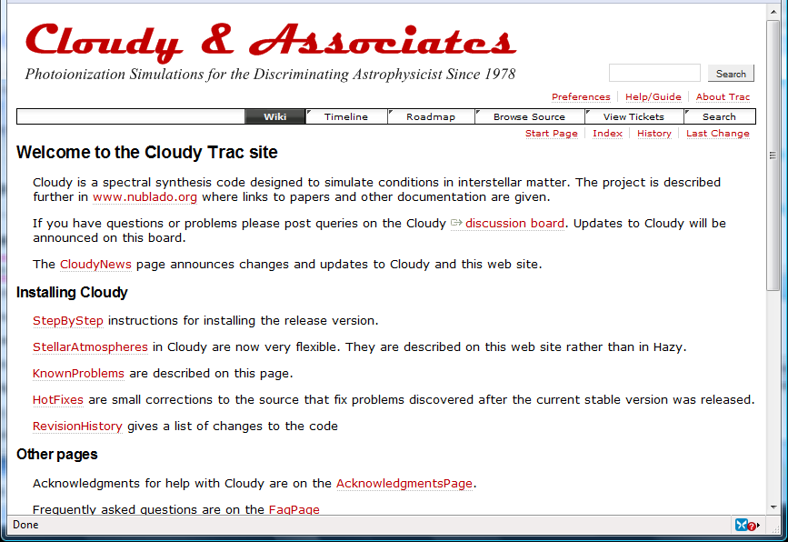
Cloudy on the web www.nublado.org

Slide 14
Some databases
Originally home-grown internal database, hardwired into code
Moving to all data external to code
Collisional ionization, Voronov 97, Dere 09
RR & DR, Badnell web site, our data
Chemistry largely based on UMIST
H₂ internal structure, lines, Meudon databases
Heavy molecules, internal structure, lines, Leiden LAMDA database

Slide 15
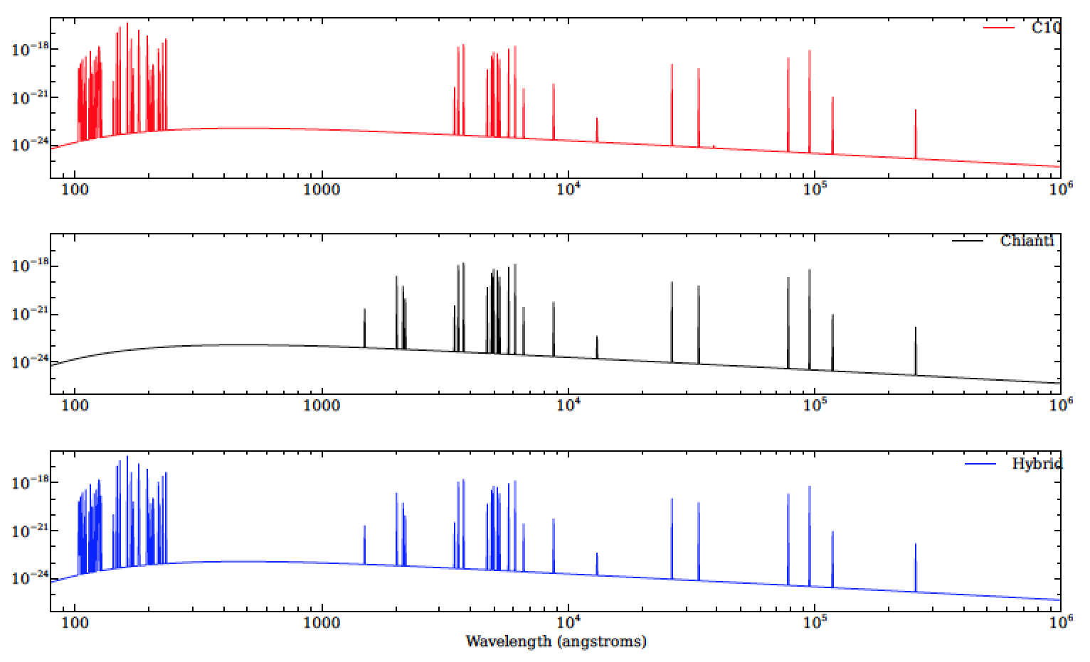
Collisional radiative cooling – Fe VII

Slide 16
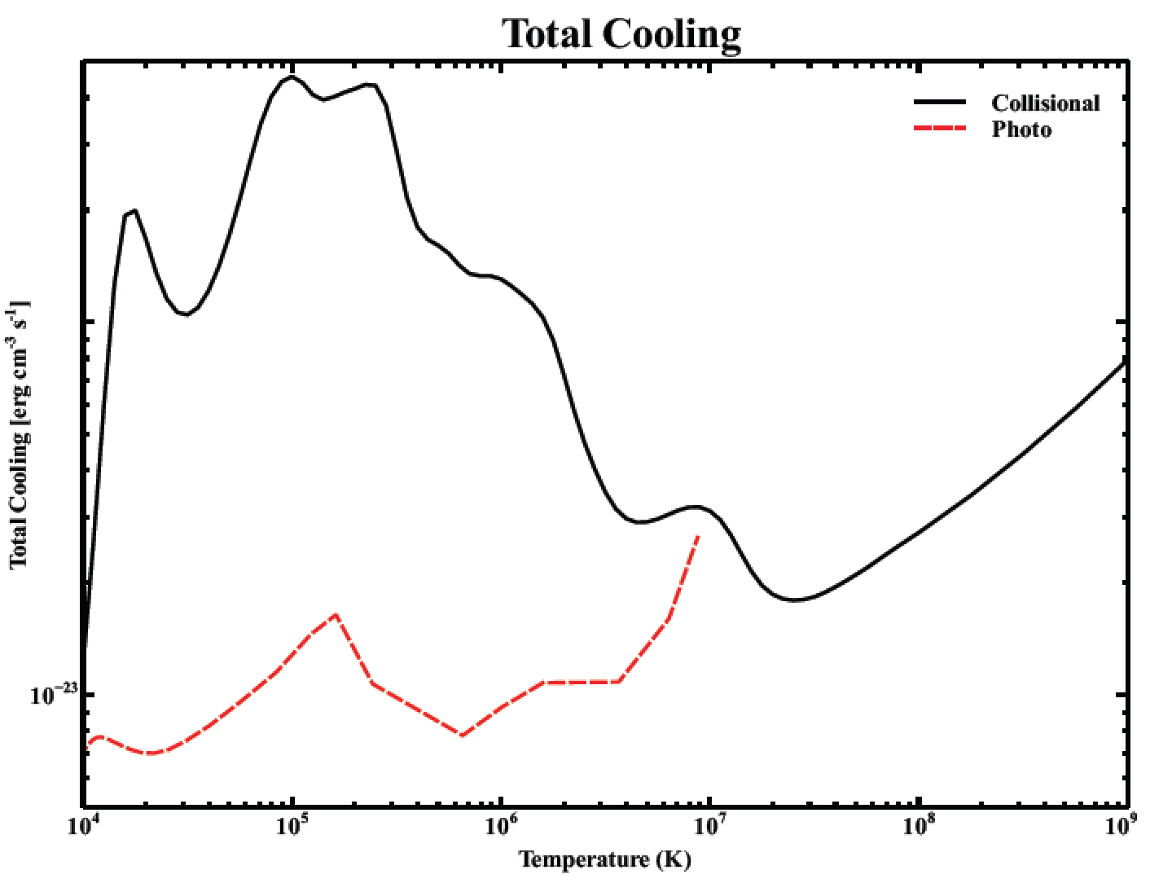

Slide 17
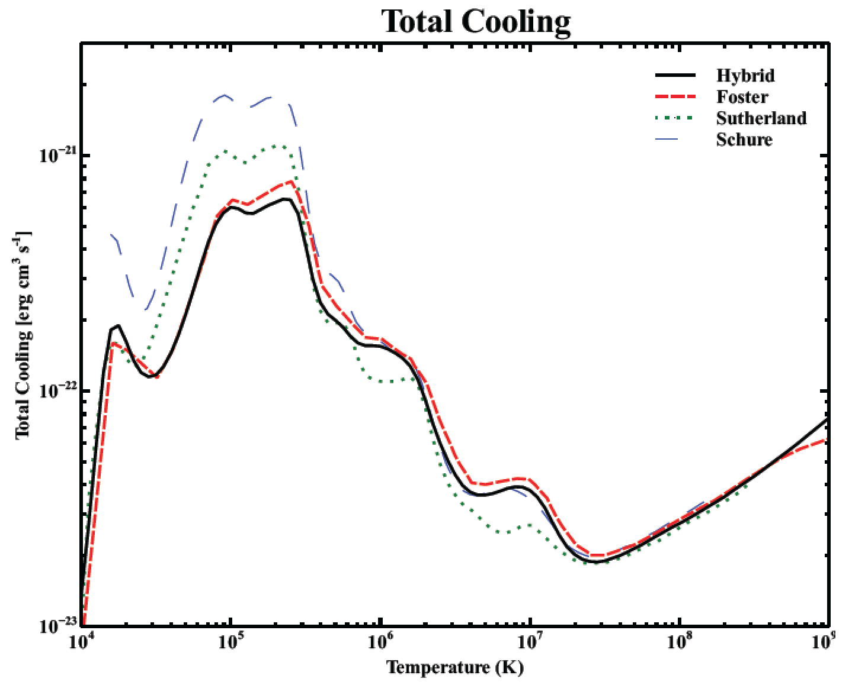
Notes:
Schure et al. (2009) cooling curve was produced using the SPEXs

Slide 18
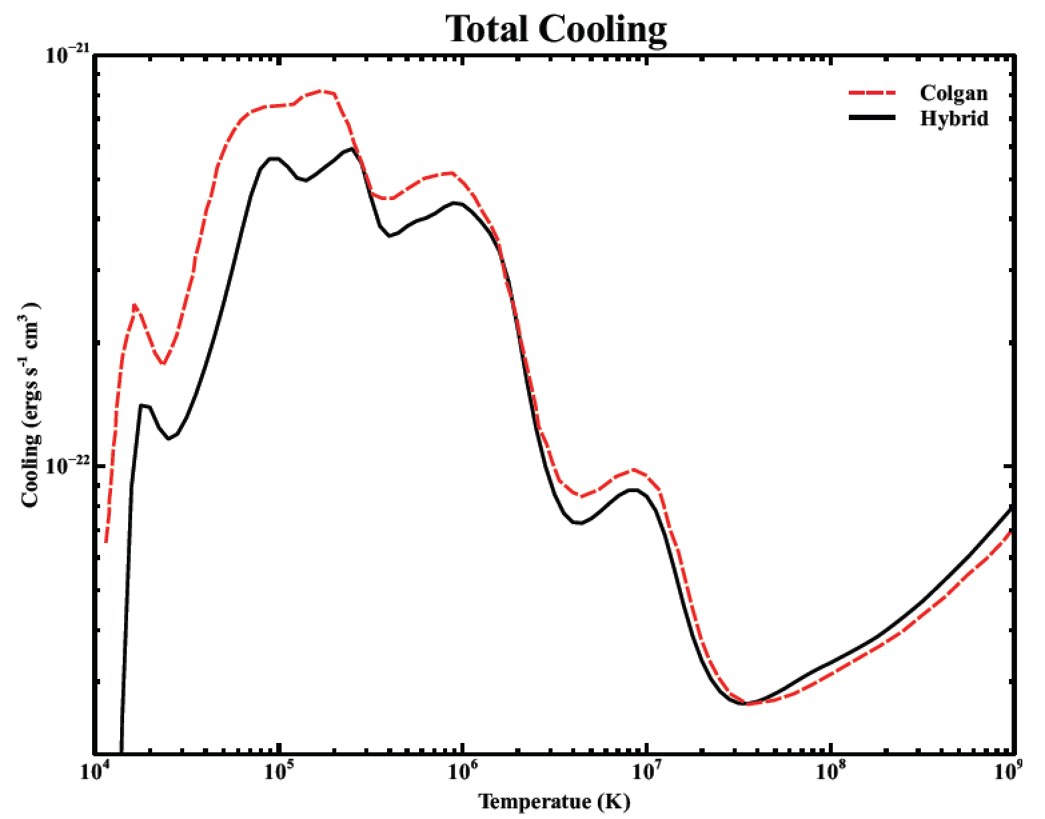
Notes:
Colgan et al. (2008) used the Los Alamos plasma kinetics code ATOMIC

Slide 19
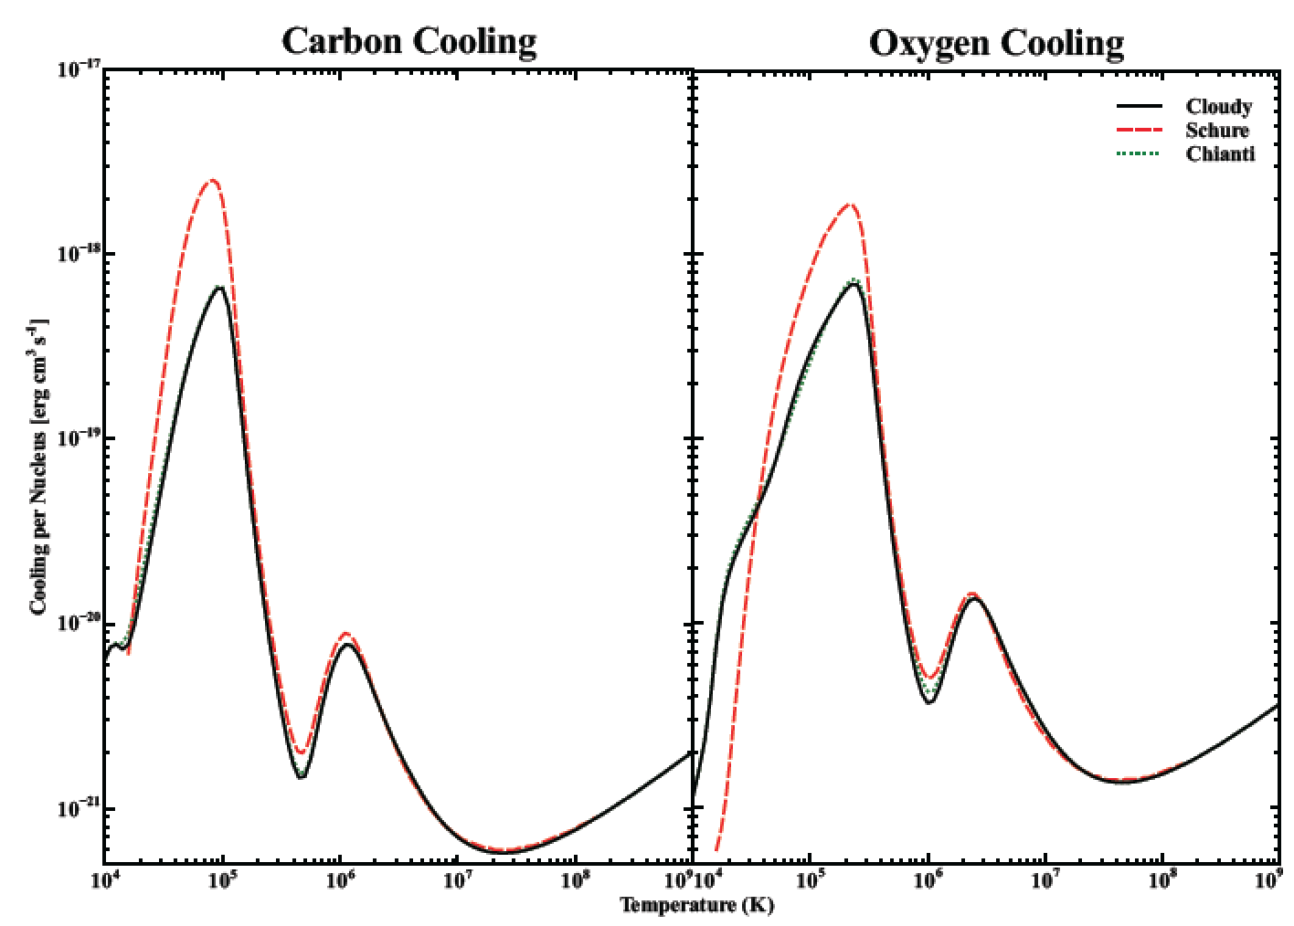

Slide 20
Astronomy
Observational, not experimental
Photos of objects
Spectrum

