Slide 1


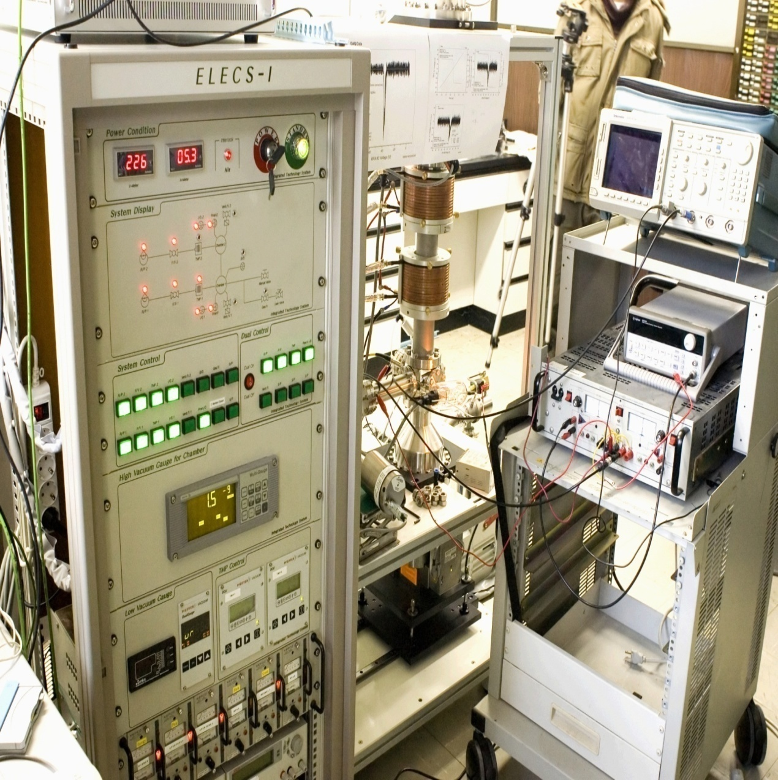
Data Center for Plasma Properties
Group Research for Evaluation of CH4 Collision Processes
Mi-Young Song
National Fusion Research Institute, South Korea

Slide 2
Contents
Introduction of CH4 group reserch
Starting point of evaluation
Evaluation of e-CH4 collision cross section
- Total, dissociation, vibration cross section
Summary

Slide 3

Co-worker
Group Members:
Y. Itikawa (Japan)
Grzegorz P. Karwasz (Nicolaus Copernicus University),
J. Tennyson (University College London)
Viatcheslav kokoouline(University of Central Florida)
H. Cho(Chung-Nam National University)
Y. Nakamura (Tokyo Denki University)
J.-S. Yoon, M.-Y. Song (National Fusion Research Institute)
Our purpose: To establish the internationally agree standard reference data library for AM/PMI data

Slide 4
We shard working part from the processes list. All coworker decide working part.
Ionization (dissociative ionization) – [Karwasz]
Total cross section- [Karwasz]
Electron Attachment [Cho]
Elastic [Cho, Itikawa]
Momentum transfer [Karwasz, Cho, Itikawa]
Vibrational excitation cross section [Karwasz, Nakamura]
Rotational excitation cross section [Itikawa, Nakamura]
Electron excitation [Cho, NFRI]
Dissociation [Cho, NFRI]

Slide 5
Starting point
To review a previous evaluation paper
W.L. Morgan, “Critical evaluation of low-energy electron impact cross sections for plasma processing modeling. II: CF4, SiH4, and CH4 ”, Plasma Chem. Plasma Process. 12, 477 (1992)
I.Kanik, S. Trajmar, and J.C. Nickel “Total electron scattering and electronic state excitations cross-sections for O2, CO, and CH4” , J. Geophys. Res. 98, 7447 (1993)
G. P. Karwasz, R. S. Bursa, and A. Zecca, “One century of experiments on electron－atom and molecule scattering: a critical review of integral cross－sections II. Polyatomic molecules” La Rivista del Nuovo Cimento 24, 1 (2001)
T. Shirai, T. Tabata, H, Tawara and Y. Itikawa, “Analytic cross sections for electron collisions with hydrocarbons: CH4, C2H6, C2H4, C2H2, C3H8, and C3H6”, Atomic Data Nucl. Data Tables 80, 147 (2002)
R.K. Janev and D. Reiter, “Collsion processes of CHy and CHy+ hydrocarbons with plasma electrons and protons”, Phys. Plasmas 9, 4071 (2002) [Revised in: D. Reiter and R.K. Janev, “Hydrocarbon collision cross sections for magnetic fusion: The methane, ethane and propane families” Contrib. Plasma Phys. 50, 986 (2010)
M.C. Fuss, A. Munoz, J.C. Oller, F. Blanco, M.-J. Hubin-Franskin, D. Almeida, P. Limao-Vieira, and G. Garcia, “Electron-methane interaction model for the energy range 0.1-10000 eV “ Chem. Phys. Lett. 486, 110 (2010)
LB Vol17C
H. Tanake et al, NIFS-DATA 108, 2009

Slide 6
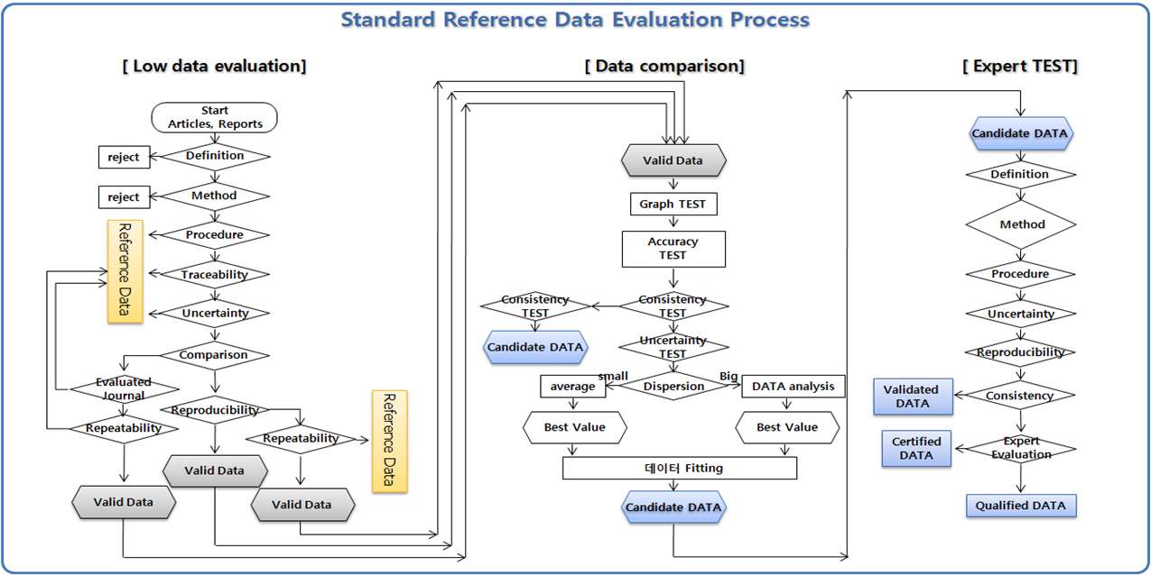
Certified data with uncertainty

Slide 7
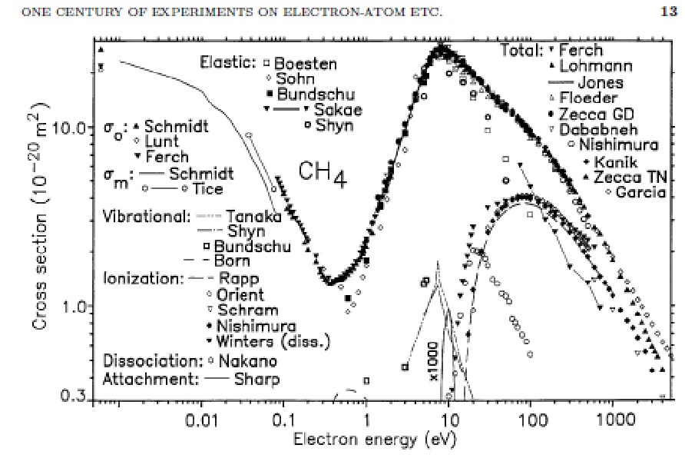
Previous evaluation
-Total collision processes
Karwasz, Brusa, Zecca (2001)

Slide 8
Total scattering cross section
Fuss at al., Garcia (2010)

Slide 9
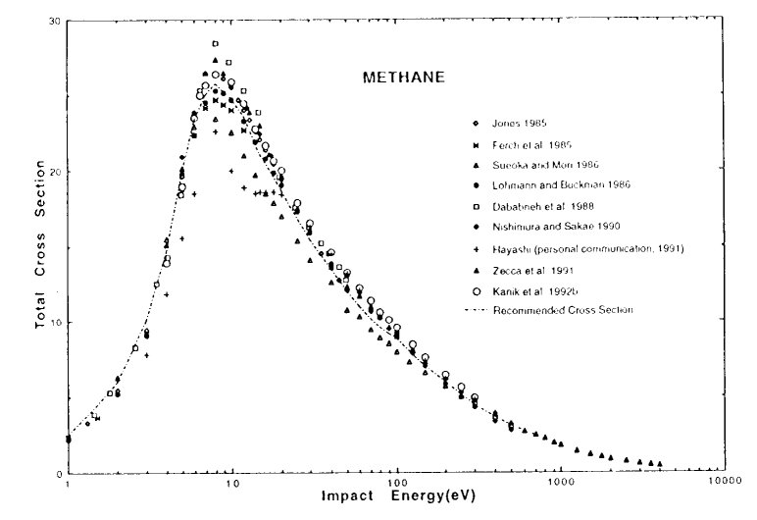
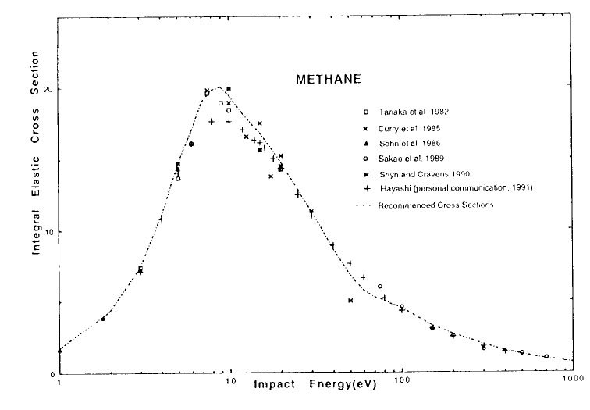
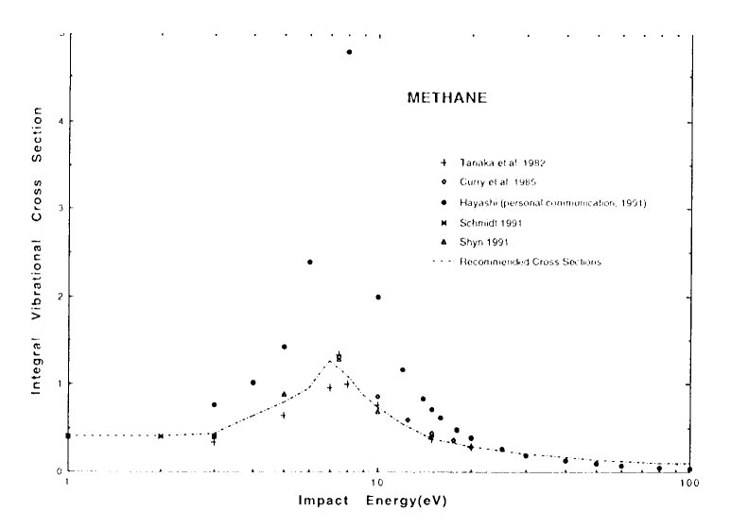
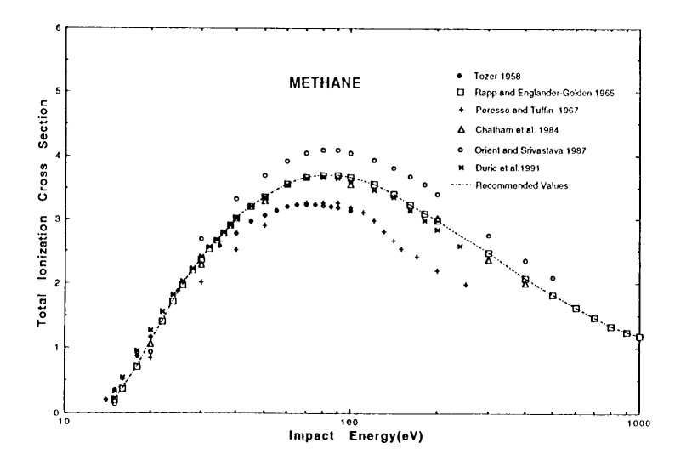
Kanik, Trajmar, Nickel (1993)

Slide 10
Shirai, Tabata, Tawara & Itikawa (2002)

Slide 11
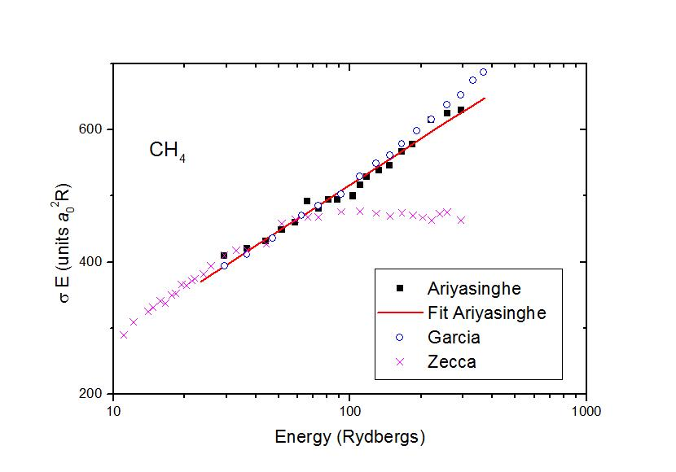
High-energy limit
Zecca/Karwasz @ above 1000 eV underestimated due to lack of retarding field analyser in their apparatus
Fig.4. Born-Bethe fit (σ/a_{o}²) (E/R) = A + B ln (E/R)
to TCS from Ariysainghe: A=52.31±17.3, B=232.2±8.6
where Rydberg constant is R=13.6 eV and the cross sections is expressed in atomic units a₀² =0.28x10⁻²⁰m²

Slide 12
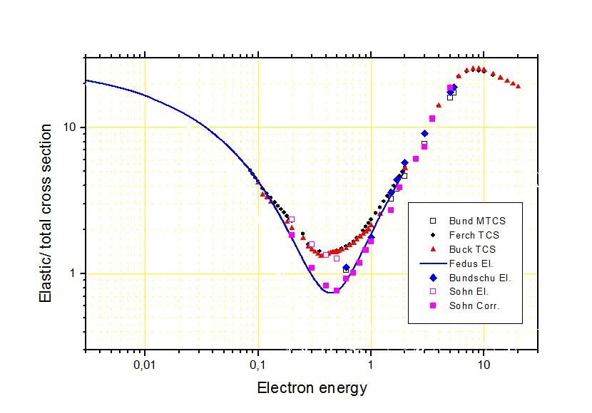
Zero-energy limit
MERT merges well @ 0.1 eV with L-B recommended (=Ferch’s and Lohmann/Buckman exp/ total)

Slide 13
L-B recommended: differences
*Karwasz, Fedus, Służewski, Karbowski

Slide 14
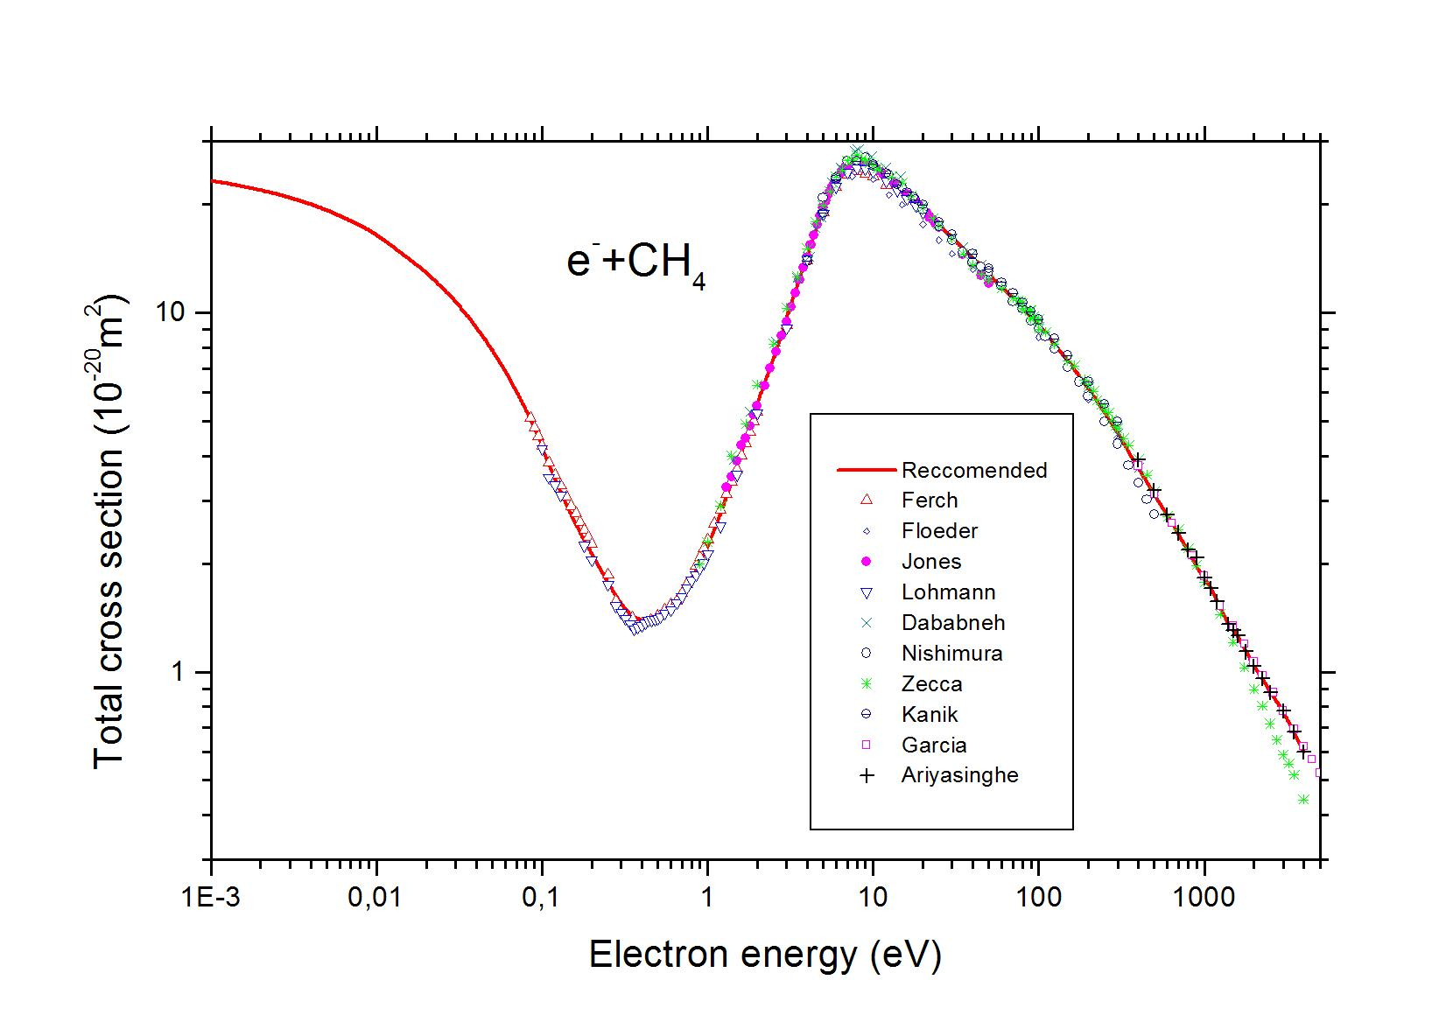
Recommended
L-B total recommended at 0.1-1000 eV
Born-Bethe fit to Ariyosanghe at 1000-4000 eV
MERT elastic below 1 eV

Slide 15
Dissociation cross section- Partial
Nakano et al (1991)
Threshold-ionization mass spectrometry
The semi-empirical total electronic-excitation cross section given by Kanik et al. [21] lies slightly above the data of Nakano et al.
[Karwasz et al 2001] In CH₄ all electronic excitation processes result in dissociation into neutral fragments, mainly into CH₃ and CH₂ fragment channels.

Slide 16
Motlagh & Moore (1998)
chemical getter technique
It measured the relative cross section for the production of CH₃ from electron impact on CH₄.
normalize the measurements to the difference‘‘(total dis.) – (total d.i.) + H⁺[d.i.]; the result is labeled ‘‘CH₃ [n.d. + d.i.].’’
FIG. 4. The cross section for the production of CH₃ by neutral dissociation (n.d.) and dissociative ionization (d.i.) from electron impact on CH₄ (•) normalized to the
difference between the total dissociation cross section [15] (■) and the total dissociative ionization cross section apart from the contribution of dissociative ionization to CH₃ production [3] (+).
The cross section for production of CH₃ by dissociative ionization is taken equal to the cross section for the production of H⁺ by dissociative ionization (X ).

Slide 17
Makochekanwa et al (2006)
Experimental Method: Crossed-beam method + threshold ionization technique
The agreement with the Motlagh et al. results gives invaluable information about the dissociation dynamics of CH₄ below 12.5 eV.
This is because Motlagh et al. assumed the cross sections for production of neutral CH₂, CH, C, and H radicals to be negligible in the absolute value conversion process for their CH₃ results.
Since Makochekanwa et al do not make any such assumption in our data analysis, this agreement thus implies that even the next significant decay channel, i.e., CH₂, is, within experimental errors, extremely marginal or nonexistent in this energy range.
FIG. 2. Quantitative comparison of the current CH₃ results with previous experimental results. Note that the 10 eV value of Motlagh et al. falls on top of our 10 eV value.

Slide 18
Recommend
Makochekanwa et al (2006)
Opinion
results for CH₃ agree both qualitatively and quantitatively with the Motlagh et al. data, even though the experimental methods are different.
Note that the Nakano et al. results have magnitudes approximately half of those of the photoabsorption data shown in Fig. 1, which could not be the case considering both optically-allowed and optically-forbidden transition in electron experiment.
Makochekanwa et al results were measured for a larger energy range with finer steps, while there are only two data points in the present energy region for each result of Motlagh & Moore and of Nakano et al.
The calibration using N from N₂ for both CH₃ and CH₂ by Nakano et al. might have affected their results.

Slide 19
Momentm Transfer cross section- Partial
Haddad (1985)- SWARM
Ohmori et al. (1986)-SWARM

Slide 20
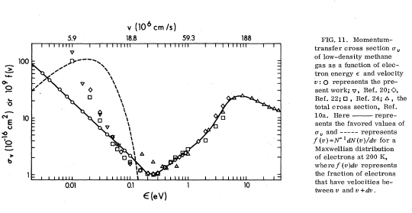
Gee and Freeman (swarm, 1979)

Slide 21
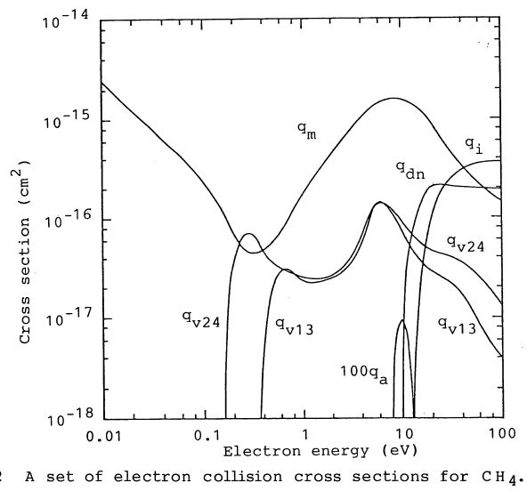
Kurachi & Nakamura (1990)
Alvarez-Pol et al. 1997 (Holstein- Boltzmann code)

Slide 22
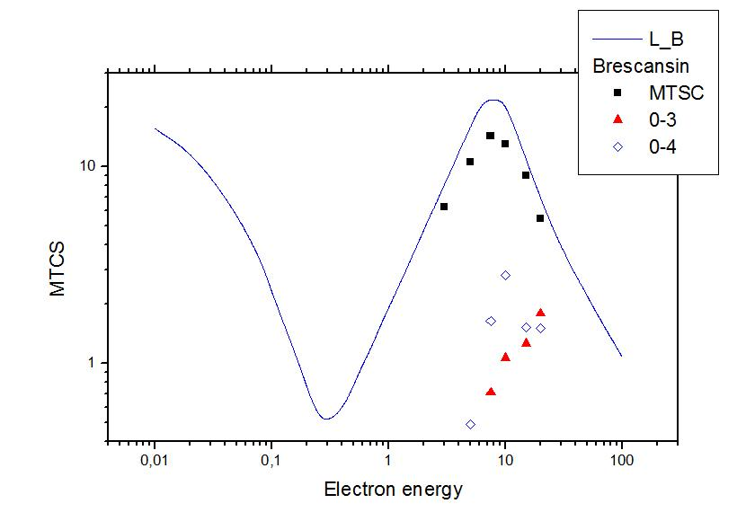
Landoldt - Börstein
Shirai, Tabata, Tawara & Itikawa (2002)

Slide 23
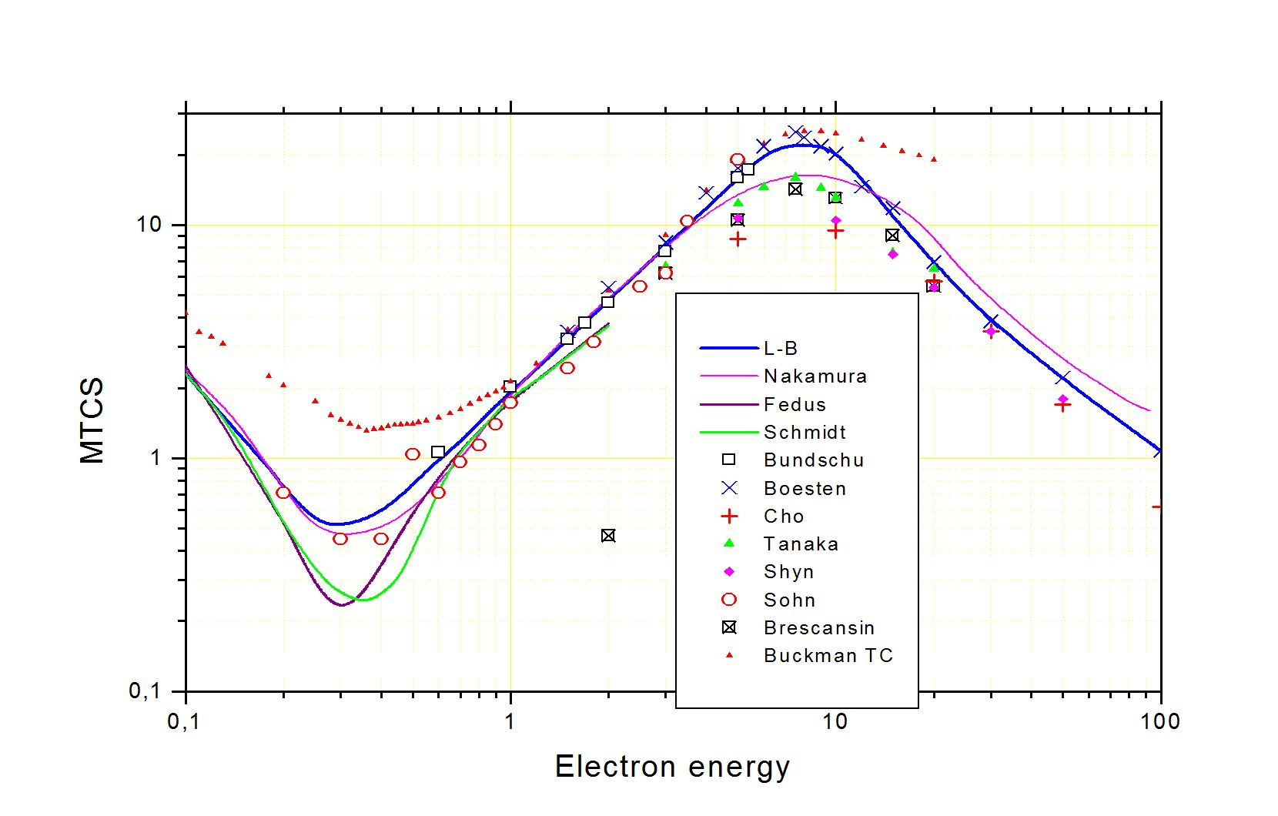
Beam experiments

Slide 24
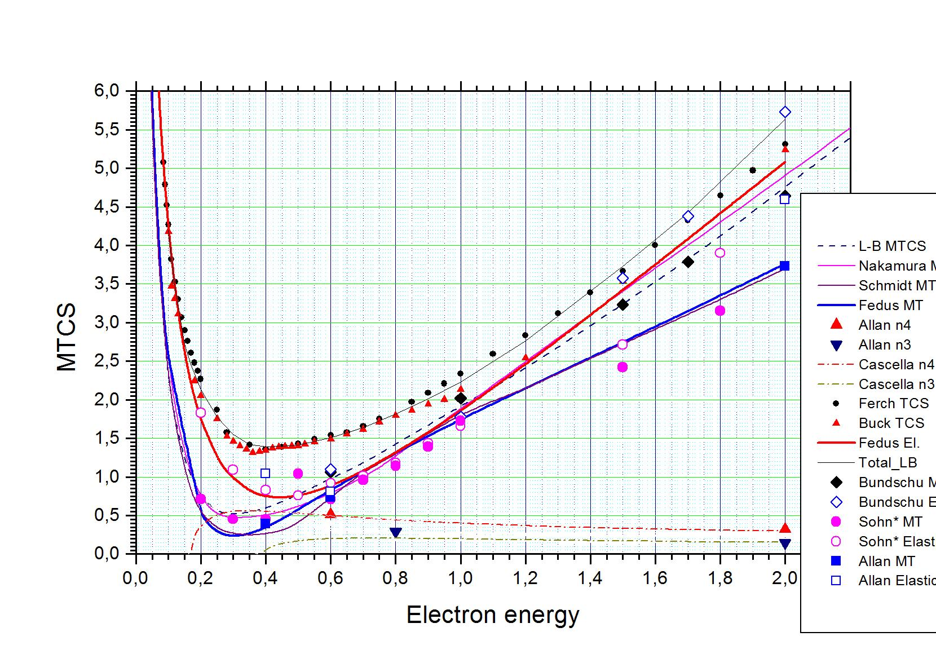
R-T minimum

Slide 25
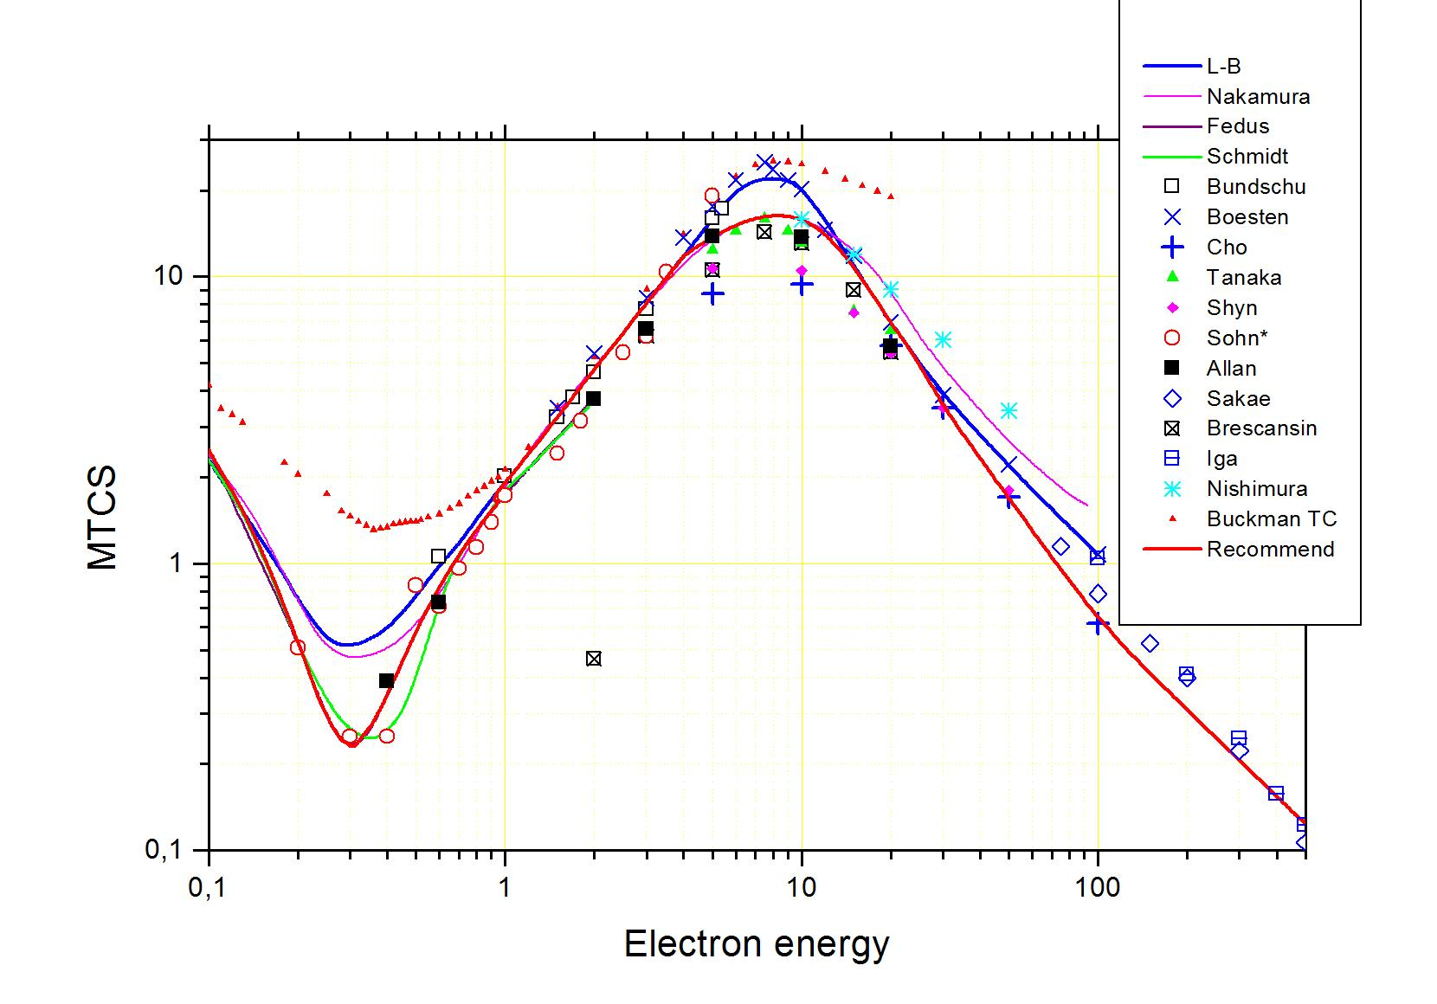
Towards recommended values

Slide 26
Recommendation
0.001 eV – 1 eV Fedus & Karwasz (2013, MERT)
1 eV- 12 eV Kurachi & Nakamura (1990)
15 eV - 30 eV Recommended Landolt-Bornstein (2003)
50 eV - 300 eV Present mean from experimental (rough evaluation)
Opinion
Allan – phase shift analysis of low-energy experiment by Allan (Fedus, 2013), see differential cross sections at selected energies
Nakamura’s data in the maximum are intermediate between upper limit (Boesten) and lower (Cho) and in v. good agreement with Allan’s (2007) data

Slide 27
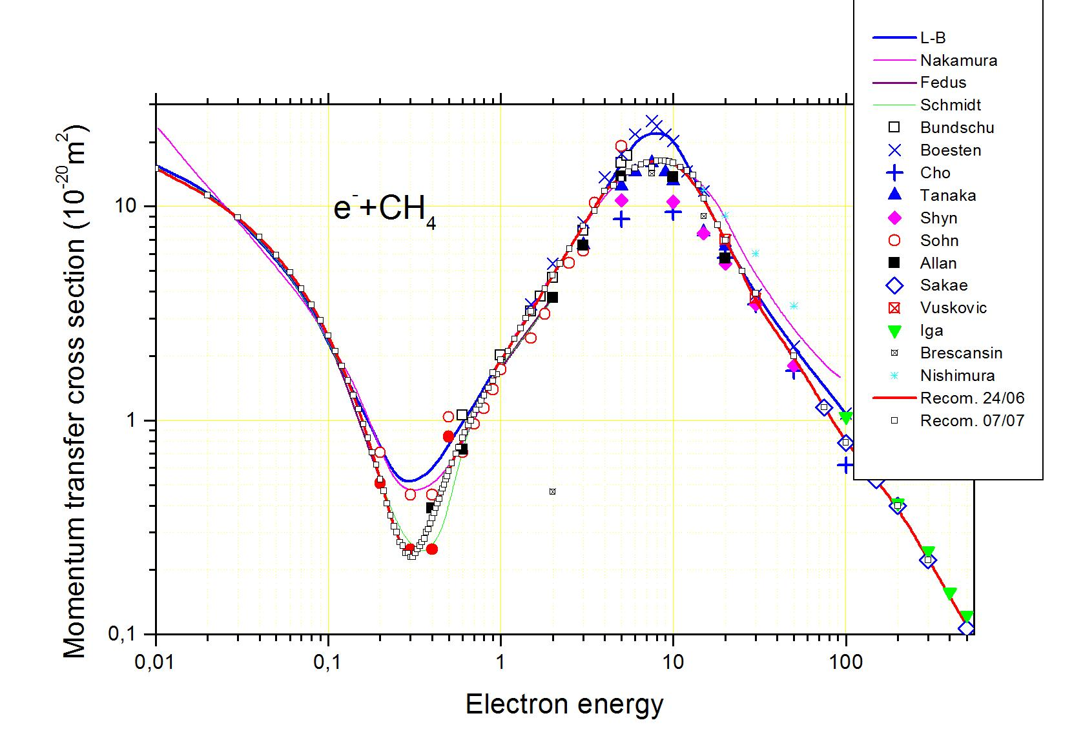
Momentum transfer cross sections in methane – a tentative recommended set (12 July 2013). L-B stays for Landoldt-Boernstein, Fedus – new MERT model, Allan – presently integrated data of (Allan 2007, and private information), Tanaka et al. (1982), Shyn and Cravens (1990), Sohn et al. (1986), theoretical are Brescansin et al. (1989) and Nishimura T. and Itikawa (1994).

Slide 28
Summary
NFRI organized the evaluation research group in this year and research together.
We will start to review a previous evaluation paper presented by all participants.
We shard working part from the processes list. All coworker decide working part.
Each members evaluate shared part and discuss result.
We suggest the recommended data of cross section of CH4 by electron impact.

