Slide 1
Pressure diagnostic for the trap center of Electron beam ion trap by EUV spectroscopy
Guiyun Liang 梁贵云
National Astronomical Observatories, CAS
Beijing, China
ADAS 2014 workshop, Sep.29-30, Warsaw, Poland

Slide 2
Outline
Brief background
EBIT and the EUV spectroscopy
Data analysis
(1) Density diagnostic
(2) Pressure diagnostic in EBIT center

Slide 3
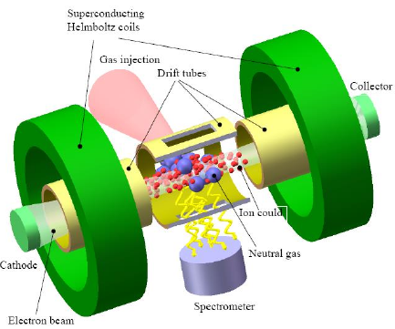
Brief background
Principle of electron beam ion trap (EBIT): electrons from electron gun is accelerated to tens of keV, then ionize material injected.
It has a powerful ability help us to benchmark theoretical model:
Produce ions of a desired charge state
Epp et al. (2010) JpB; Beiersdorfer (2003) ARAA

Slide 4
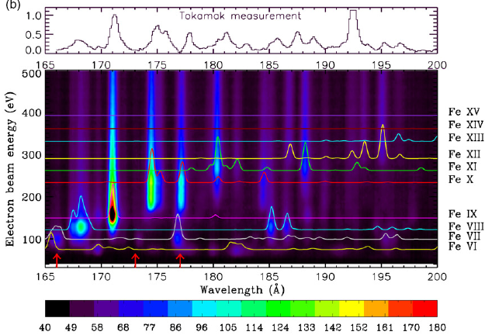
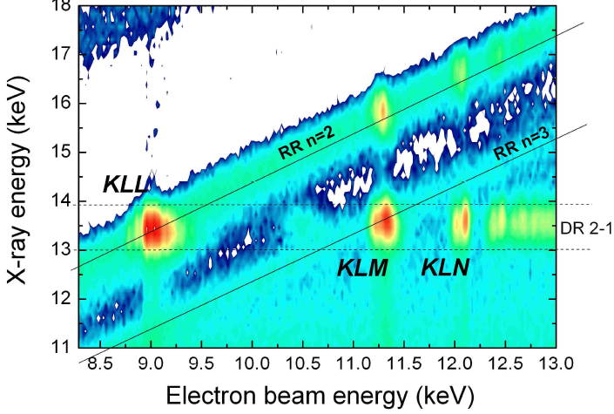
Determine which lines come from which charge stage.
Study emission by selecting specific line formation processes
Liang et al. (2009) ApJ; Martínez PhD thesis (2005)

Slide 5
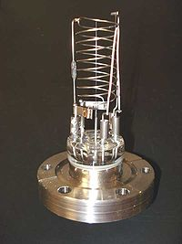
However, the EBIT behavior is affected by pressure or vacuum of the trap, which is a fundamental parameter in experiments
Usually, the pressure is measured by ionization gauge method for high vacuum (10⁻³ —10⁻¹⁰ mbar):
Principle: By measuring the electrical ions produced when the gas is bombarded with electrons.
Accuracy: depends on the chemical composition of gases being measured, corrosion and surface deposits

Slide 6
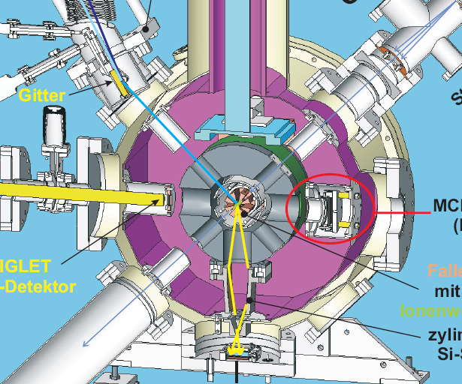
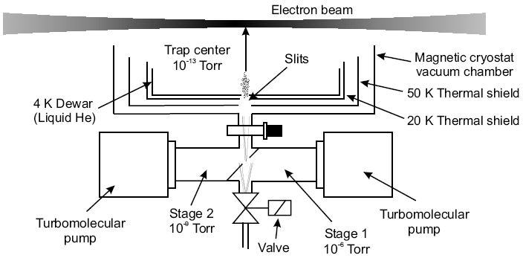
The central space is very small (55mm×10/3mm) to located a vacuum gauge.
It is separate from other space by cooling system and Helmholtz coils
What we measured pressure (10⁻⁸mbar) represents the value around the chamber wall.
Epp PhD thesis (2007)

Slide 7
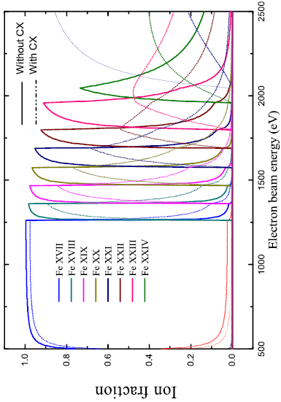
In theory, charge stage distribution will be smeared out due to the Charge-exchange between trapped ions with residual neutral gas, that can be regarded as a ‘recombination’ gauge.
The neutral density is proportional to the pressure in the trap center.

Slide 8
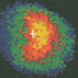
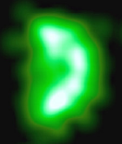
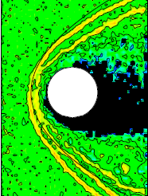
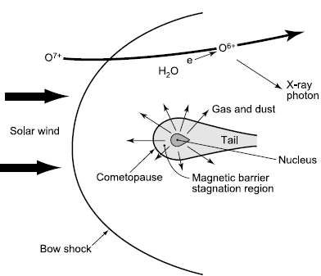
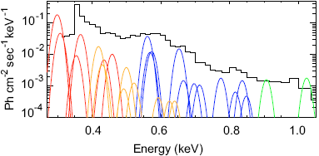
X-ray on planetary/cometary atmospheres due to CX process
Observation comet and vernus Lisse et al. (1996)
Simulation of solar wind ions on Martian, Modolo et al. (2005)
Bodewits et al. (2006)
What components in solar wind?
What velocity of these ions?
Where these ions from on solar surface?

Slide 9
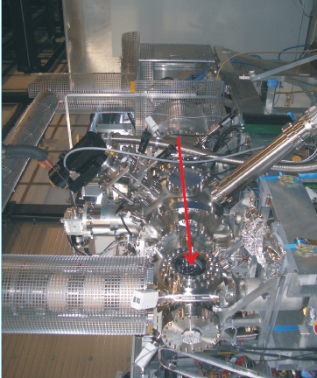
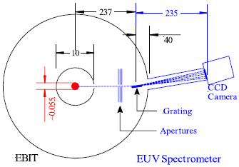
EUV spectra measurement in EBIT
Heidelberg FLASH/Tesla EBIT
EUV spectrometer
Grazing grating: 2400l/mm
CCD 2048×2048, 13.5μm/pixel
Beam energies: 100 — 3000 eV
Energy step: 10 or 20 eV
Photon energies: 90 — 260 Å
Photon resolution: ~0.3 Å
Pressure: ~ 10⁻⁸ mbar
Epp PhD thesis (2007)

Slide 10
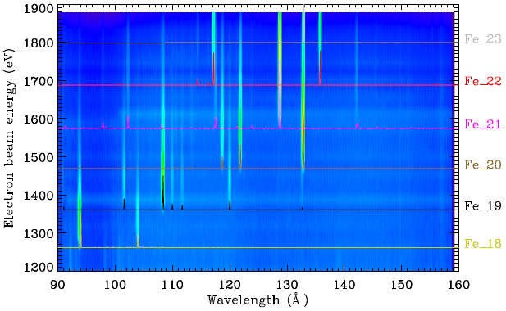
Above shows the resultant spectra of highly charged iron ions. Any analysis is based upon the good spectral modelling.

Slide 11
Data analysis
Fitting to obs.
Analysis model
Output: emissivity
Approx.-coding
Atomic data
Physics: Liang et al. (2014) ApJ

Slide 12
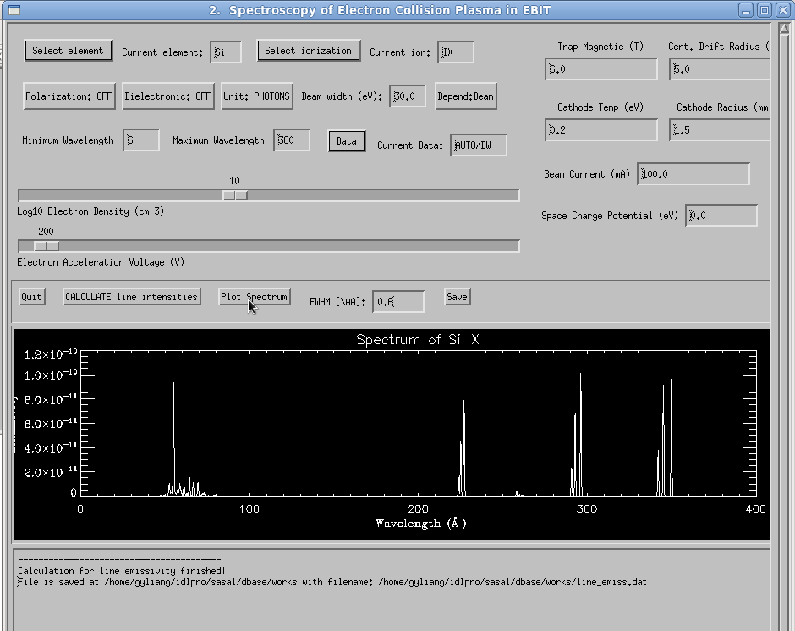
Line identification
Cross section is from FAC and AUTOSTRUCTURE

Slide 13
I_{obs}(γ) = A_{i}(E)⋅η(γ)⋅ε(γ, E)
Here, A_{i}(E) is the ionic abundance as a function of beam energy, η(γ) is the efficiency of the spectrometer, and ε(γ, E) is the line emissivity, where E refers to the beam energy
There is two method to generate the ‘evolution curve’ A_{i}(E)
Global fitting
Single line fitting
Line emissivity: ε ~ σ(E) or
ε=A_{ij}N_{j}
For resonant lines, the uncertainty of σ(E) is within 5%
Cascading effect will have <10% contribution for line emissivity.

Slide 14

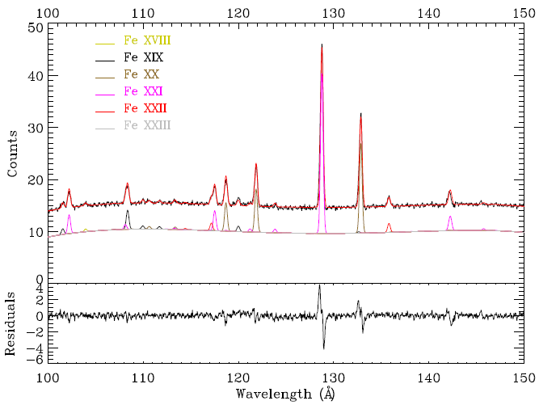
Adopting global fitting, at each pixel channel and at a given energy,

Slide 15
Evolution curve of ionic fraction

Slide 16
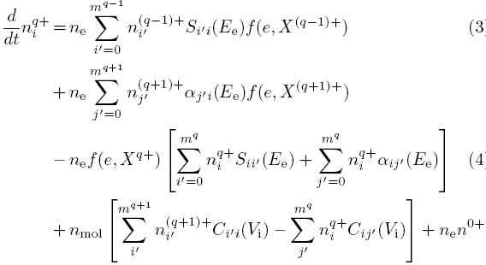
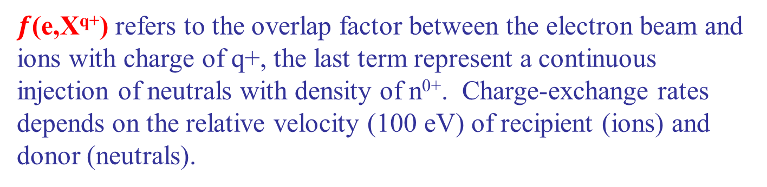
Charge state distribution
$f$(e,X^{q+}) refers to the overlap factor between the electron beam and ions with charge of q+, the last term represent a continuous injection of neutrals with density of n⁰⁺. Charge-exchange rates depends on the relative velocity (100 eV) of recipient (ions) and donor (neutrals).

Slide 17
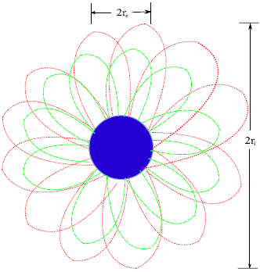
EUV spectroscopic application to EBIT
1. Effective electron density in trap

Slide 18
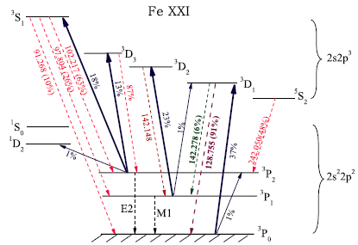
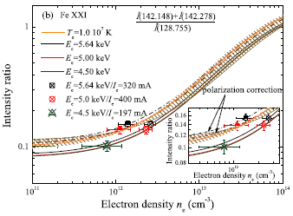
Line ratios involved emission lines with its upper level is dominantly populated from metastable levels
Resultant electron density is about 10¹²cm⁻³

Slide 19
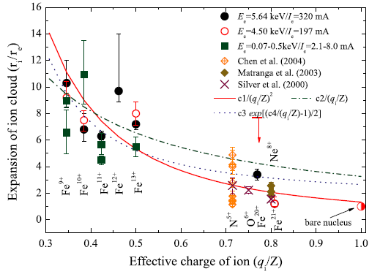
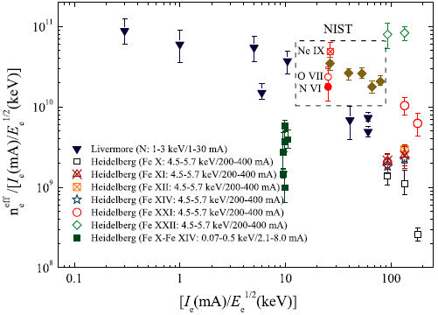
2. Overlap factor between e-beam and trapped ions
The overlap factor depends on the ionic charge

Slide 20
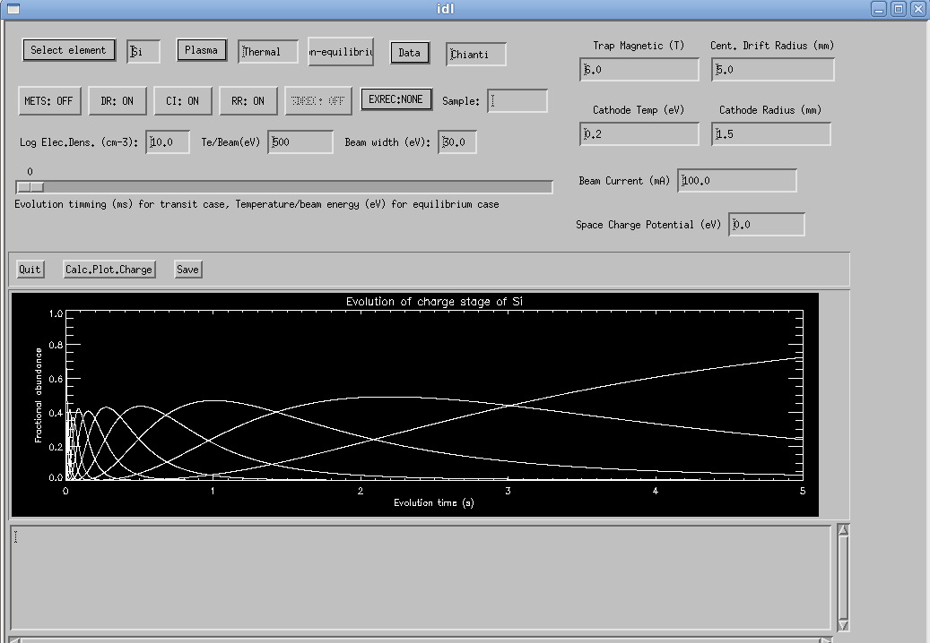
The module of charge stage distribution
Plasma type:
Thermal
EBIT
EBIT/R with escape
PhiBB
CXERec

Slide 21
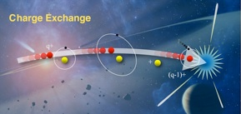
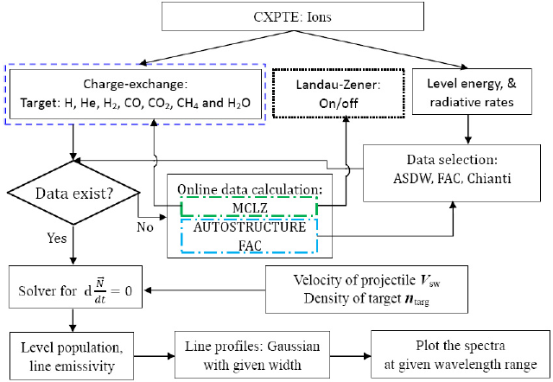
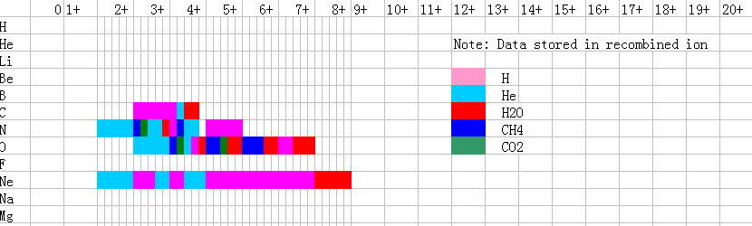
Charge exchange
Donors:
H (13.61)
He (24.59)
H2 (15.43)
CO (14.10)
CO2 (13.78)
H20 (12.56)
CH4 (12.6)
Treatment of CX cross-section:
Default is parameterized Landau-Zener approximation
Collection from published data (RARE!)
Hydrogenic model

Slide 22
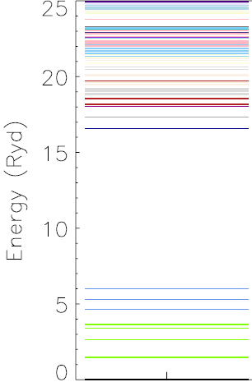
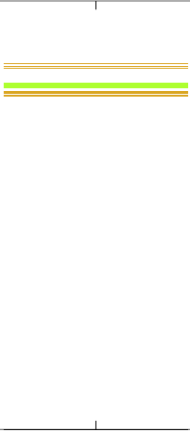



Obtain the average energy of captured nl (3d) orbital
Using parameterized MCLZ approximation obtain the nl-manifold CX cross-section
Statistical weight to get the nlJ-resolved cross-section
2s 2p 3d
In Hydrogenic model:
Obtain the principle quantum number with peak fraction.
2s² 2p (ground)
‘Landau-Zener’ weight as
Statistical weight
Si¹⁰⁺ projectile
Smith et al. (2012)

Slide 23
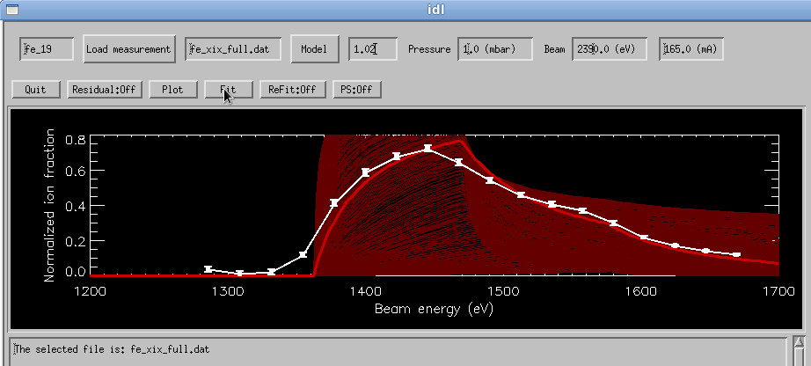
Monte-Carlo method is adopted to obtain optimized neutral density with 300×300 tests
At low beam energies, the uncertainty (~10 eV) may be due to estimation of space charge potential, because only beam current at high energy recorded for #Fe1008 and #Fe1208

Slide 24
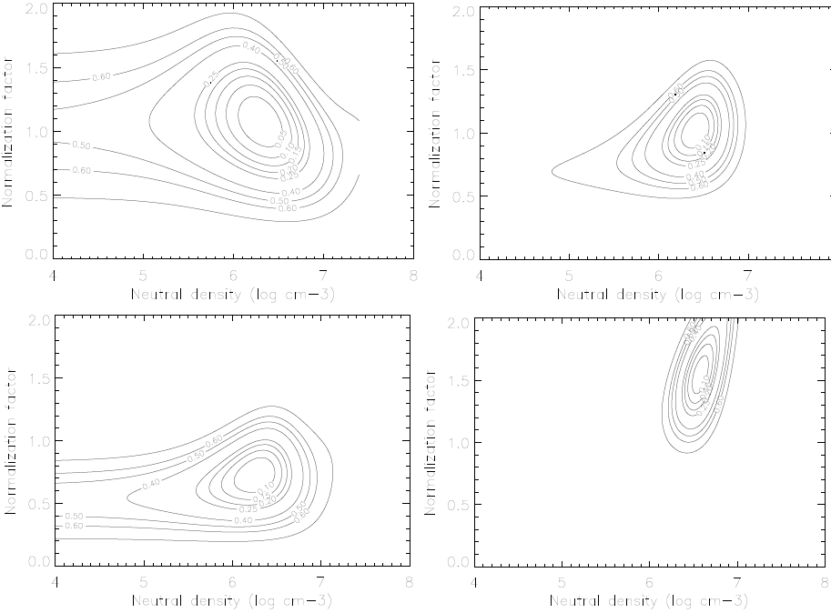
Fe XVIII
Fe XIX
Fe XX
Fe XXI

Slide 25
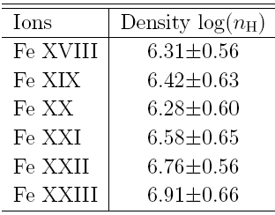
The resultant neutral density at the trap center without consider the overlap factor between electron beam and ion cloud
At a current of 165 mA, and the beam energy 2390 eV, the largest central electron density is about 1.4×10¹³cm⁻³
An effective electron density is diagnosed to be 2.6×10¹² cm⁻³

Slide 26
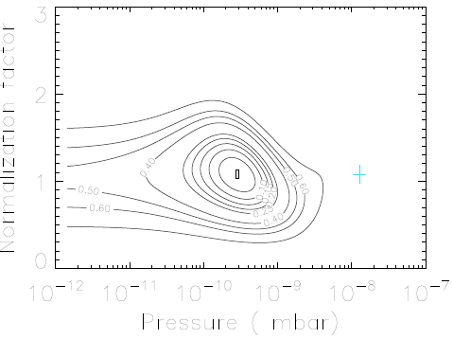
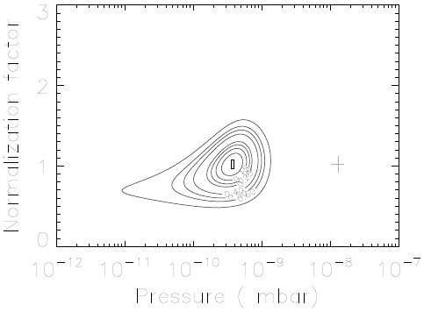
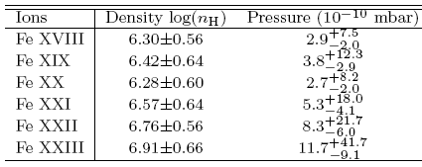

Fe XVIII
Fe XIX
The resultant pressure in trap center is obtained, that is still higher than expectation.

Slide 27
In the central region, NO ‘quantitative’ value available, except for a ‘qualitative’ estimation. The present diagnostic strongly depends on the underlying model. A further analysis is on-going.

Slide 28



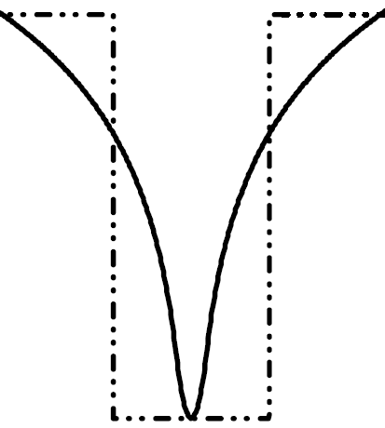


Coulomb heating:
Energy transfer between ions:
Ion escape (radial, axial):
V_{radial}
Energy loss due to escaping ions:
V_{axial}=100V
Penetrante et al. (1991)

Slide 29
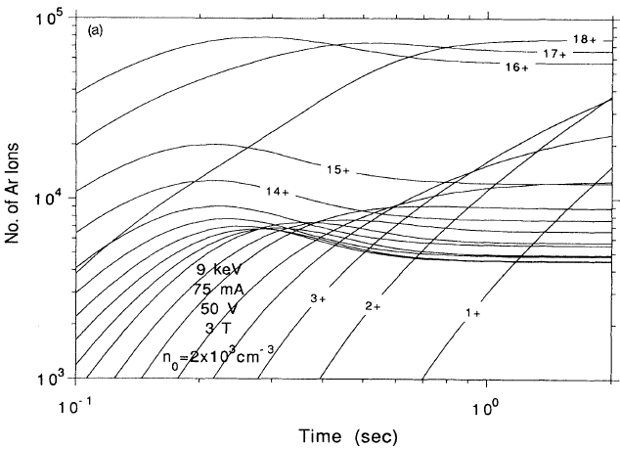
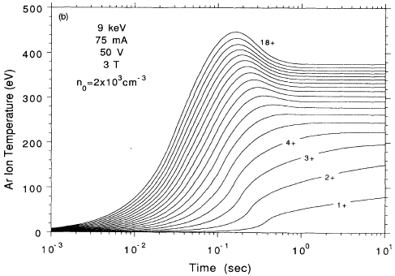
Evolution of ions and ionic temperature:
Penetrate et al. PRA (1991)

Slide 30
Summary
Brief background
EBIT and the EUV spectroscopy
Data analysis
a. Density diagnostic
b. Diagnostic for overlap factor between beam and ions
c. Diagnostic to the pressure in the EBIT center

Slide 31
Thanks you for your attention!

